Slide 1

VPN with Mobile Devices revisited
55. DFN Betriebstagung Oktober 2011 Berlin
Prof. Dr. Andreas Steffen
Institute for Internet Technologies and Applications
HSR Hochschule für Technik Rapperswil
andreas.steffen@hsr.ch

Slide 2
Problemkreise bei Mobile Devices
Multihoming bei mehreren Netzwerkkarten (UMTS, WLAN, etc)
➔ IKEv2 MOBIKE Protokoll (RFC 4555)
Routing im Innern des Tunnels bei dynamischen IP Adressen
➔ Vergabe von virtuellen IP Adressen durch Pool oder DHCP
Verfügbarkeit des Gateways
➔ High Availability & Load Sharing
Durch Malware verseuchte Mobile Devices
➔ Trusted Network Connect & Platform Trust Service

Slide 3
VPN with Mobile Devices revisited
55. DFN Betriebstagung Oktober 2011 Berlin
MOBIKE – Mobility and Multihoming Protocol

Slide 4
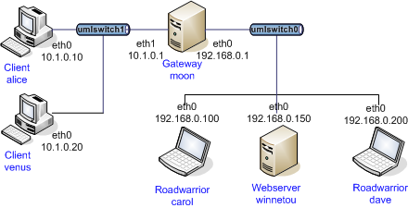
IKEv2 Remote Access Szenario
#ipsec.secrets for roadwarrior carol
: RSA carolKey.pem "nH5ZQEWtku0RJEZ6"
#ipsec.secrets for gateway moon
: RSA moonKey.pem
#ipsec.conf for roadwarrior carol
conn home
keyexchange=ikev2
leftsourceip=%config
leftcert=carolCert.pem
leftid=carol@strongswan.org
leftfirewall=yes
right=moon.strongswan.org
rightid=@moon.strongswan.org
rightsubnet=10.1.0.0/16
auto=start
#ipsec.conf for gateway moon
config setup
plutostart=no #IKEv1 not needed
conn rw
keyexchange=ikev2
leftsubnet=10.1.0.0/24
leftcert=moonCert.pem
leftid=@moon.strongswan.org
leftfirewall=yes
right=%any
rightsourceip=10.3.0.0/24
auto=add

Slide 5

VPN Multihoming Szenario I
GSM/UMTS
C2
Internet
V
C3
C1
VPN Client
Public WLAN
G2
S
G1
G3
Intranet
Local WLAN
VPN Gateway
Notes:
N Rekeying Notification (optional)
SA_{i} Suite of cryptographic proposals for the Child SA (ESP and/or AH)
N_{i} Initiator Nonce
KE_{i} Initiatior public factor for the Diffie-Hellman Key Exchange (optional PFS)
TS_{i} Initiator Traffic Selectors (subnets behind the Initiator)
TS_{r} Responder Traffic Selectors (subnets behind the Responder
SA1_{r} Selection of a cryptographic proposal for the IKE SA
N_{r} Responder Nonce
KE_{r} Responder public factor for the Diffie-Hellman Key Exchange (optional PFS)
TS_{i} Initiator Traffic Selectors (subnets behind the Initiator)
TS_{r} Responder Traffic Selectors (subnets behind the Responder

Slide 6
VPN Multihoming Szenario II
Lokale WLAN Verbindung, UMTS Interface im Standby
C1 -> G1: IKE_SA Req #0 [ SA KE No N(NATD_S_IP) N(NATD_D_IP) ]
C1 <- G1: IKE_SA Res #0 [ SA KE No N(NATD_S_IP) N(NATD_D_IP) ... ]
C1 -> G1: IKE_AUTH Req #1 [ IDi N(MOBIKE_SUP) N(ADD_4_ADDR C2) ... ]
C1 <- G1: IKE_AUTH Res #1 [ IDr N(MOBIKE_SUP) N(ADD_4_ADDR G2) N(ADD_4_ADDR G3) ]
IPsec SA: C1 <-> G1
IPsec Policy: V/32 <-> S/32
VPN Client verlässt lokales WLAN und schaltet Defaultroute auf UMTS um
C2 -> G1: INFORMATIONAL Req #2 [ ]
C2 -> G2: INFORMATIONAL Req #2 [ ]
C2 -> G3: INFORMATIONAL Req #2 [ ]
C2 <- G2: INFORMATIONAL Res #2 [ ]
C2 -> G2: INFORMATIONAL Req #3 [ N(UPD_SA_ADDR) N(NATD_S_IP) N(NATD_D_IP) N(COOKIE2) ]
C2 <- G2: INFORMATIONAL Res #3 [ N(NATD_S_IP) N(NATD_D_IP) N(COOKIE2) ]
IPsec SA: C2 <-> G2
IPsec Policy: V/32 <-> S/32
Der IPsec Tunnel muss nicht neu aufgebaut werden.
Es wird nur die IPsec SA via IKEv2 MOBIKE (RFC 4555) aufdatiert
Knacknuss: Wie sollen die gefundenen Routen priorisiert werden?
Notes:
N Rekeying Notification (optional)
SA_{i} Suite of cryptographic proposals for the Child SA (ESP and/or AH)
N_{i} Initiator Nonce
KE_{i} Initiatior public factor for the Diffie-Hellman Key Exchange (optional PFS)
TS_{i} Initiator Traffic Selectors (subnets behind the Initiator)
TS_{r} Responder Traffic Selectors (subnets behind the Responder
SA1_{r} Selection of a cryptographic proposal for the IKE SA
N_{r} Responder Nonce
KE_{r} Responder public factor for the Diffie-Hellman Key Exchange (optional PFS)
TS_{i} Initiator Traffic Selectors (subnets behind the Initiator)
TS_{r} Responder Traffic Selectors (subnets behind the Responder

Slide 7
VPN with Mobile Devices revisited
55. DFN Betriebstagung Oktober 2011 Berlin
Virtual IP Address Pools & DHCP Support

Slide 8
VPN Routing ohne Virtuelle IP Adresse
VPN Gateway
Firewall blockt!
C1
C1
G1
G2
S
VPN Tunnel
VPN Client
Intranet
ungeschützt!
D
Default Gateway
Notes:
N Rekeying Notification (optional)
SA_{i} Suite of cryptographic proposals for the Child SA (ESP and/or AH)
N_{i} Initiator Nonce
KE_{i} Initiatior public factor for the Diffie-Hellman Key Exchange (optional PFS)
TS_{i} Initiator Traffic Selectors (subnets behind the Initiator)
TS_{r} Responder Traffic Selectors (subnets behind the Responder
SA1_{r} Selection of a cryptographic proposal for the IKE SA
N_{r} Responder Nonce
KE_{r} Responder public factor for the Diffie-Hellman Key Exchange (optional PFS)
TS_{i} Initiator Traffic Selectors (subnets behind the Initiator)
TS_{r} Responder Traffic Selectors (subnets behind the Responder

Slide 9
VPN Routing mit Virtueller IP Adresse
Virtuelle IP und DNS Information via IKEv2 Configuration Payload
VPN Gateway
V1
C1
G1
V Pool
G2
S
VPN Tunnel
VPN Client
Intranet
Route: V Pool via G2
D
ICMP Redirect
Default Gateway
Notes:
N Rekeying Notification (optional)
SA_{i} Suite of cryptographic proposals for the Child SA (ESP and/or AH)
N_{i} Initiator Nonce
KE_{i} Initiatior public factor for the Diffie-Hellman Key Exchange (optional PFS)
TS_{i} Initiator Traffic Selectors (subnets behind the Initiator)
TS_{r} Responder Traffic Selectors (subnets behind the Responder
SA1_{r} Selection of a cryptographic proposal for the IKE SA
N_{r} Responder Nonce
KE_{r} Responder public factor for the Diffie-Hellman Key Exchange (optional PFS)
TS_{i} Initiator Traffic Selectors (subnets behind the Initiator)
TS_{r} Responder Traffic Selectors (subnets behind the Responder

Slide 10
Flüchtiger RAM-basierter IP Address Pool
Konfiguration in ipsec.conf
conn rw
...
rightsourceip=10.3.0.0/24
auto=add
Statistik
ipsec leases
Leases in pool 'rw', usage: 2/255, 2 online
10.3.0.2 online 'dave@strongswan.org'
10.3.0.1 online 'carol@strongswan.org'
Referenzieren eines RAM-basierten Pools
conn rw1
...
rightsourceip=%rw
auto=add
Notes:
Using built-in IP address pools
• http://wiki.strongswan.org/projects/strongswan/wiki/VirtualIp
Using a local DHCP server via dhcp plugin
• http://wiki.strongswan.org/projects/strongswan/wiki/DHCPPlugin
Configuration attributes from strongswan.conf via attr plugin
• http://wiki.strongswan.org/projects/strongswan/wiki/AttrPlugin

Slide 11
Persistenter SQL-basierter IP Address Pool I
SQLite Datenbankschema
http://wiki.strongswan.org/repositories/entry/strongswan/
testing/hosts/default/etc/ipsec.d/tables.sql
Erstellen der SQLite Datenbank
cat /etc/ipsec.d/table.sql | sqlite3 /etc/ipsec.d/ipsec.db
Verbinden mit der SQLite Datenbank
# /etc/strongswan.conf - strongSwan configuration file
libhydra {
plugins {
attr-sql {
database = sqlite:///etc/ipsec.d/ipsec.db
}
}
}

Slide 12
Persistenter SQL-basierter IP Address Pool II
Definition des Pools
ipsec pool --add bigpool --start 10.3.0.1 --end 10.3.0.254 --timeout 48
allocating 254 addresses... done.
Konfiguration in ipsec.conf
conn rw
...
rightsourceip=%bigpool
auto=add
Statistik
ipsec pool –-status
name start end timeout size online usage
bigpool 10.3.0.1 10.3.0.254 48h 254 1 ( 0%) 2 ( 0%)
ipsec pool --leases --filter pool=bigpool
name address status start end identity
bigpool 10.3.0.1 online Oct 22 23:13:50 2009 carol@strongswan.org
bigpool 10.3.0.2 valid Oct 22 23:14:11 2009 Oct 22 23:14:25 2009 dave@strongswan.org
Notes:
Creating SQL-based address pools and configuration attributes
http://wiki.strongswan.org/projects/strongswan/wiki/IpsecPool
Configuration of the attr-sql plugin
• http://wiki.strongswan.org/projects/strongswan/wiki/AttrSQL

Slide 13
VPN Gateway als ARP und DHCP Proxy
VPN Gateway verlangt vom DHCP Server lokale IP Adresse
und sendet sie via IKEv2 Configuration Payload an VPN Client.
VPN Gateway
L1
C1
G1
L1
G2
S
VPN Tunnel
VPN Client
Lokales
LAN
L Pool
D
ARP Broadcasts
DHCP Server
VPN Gateway beantwortet stellvertretend für VPN Client ARP Anfragen. Dadurch werden IP Pakete an den VPN Client automatisch getunnelt.
Notes:
N Rekeying Notification (optional)
SA_{i} Suite of cryptographic proposals for the Child SA (ESP and/or AH)
N_{i} Initiator Nonce
KE_{i} Initiatior public factor for the Diffie-Hellman Key Exchange (optional PFS)
TS_{i} Initiator Traffic Selectors (subnets behind the Initiator)
TS_{r} Responder Traffic Selectors (subnets behind the Responder
SA1_{r} Selection of a cryptographic proposal for the IKE SA
N_{r} Responder Nonce
KE_{r} Responder public factor for the Diffie-Hellman Key Exchange (optional PFS)
TS_{i} Initiator Traffic Selectors (subnets behind the Initiator)
TS_{r} Responder Traffic Selectors (subnets behind the Responder

Slide 14
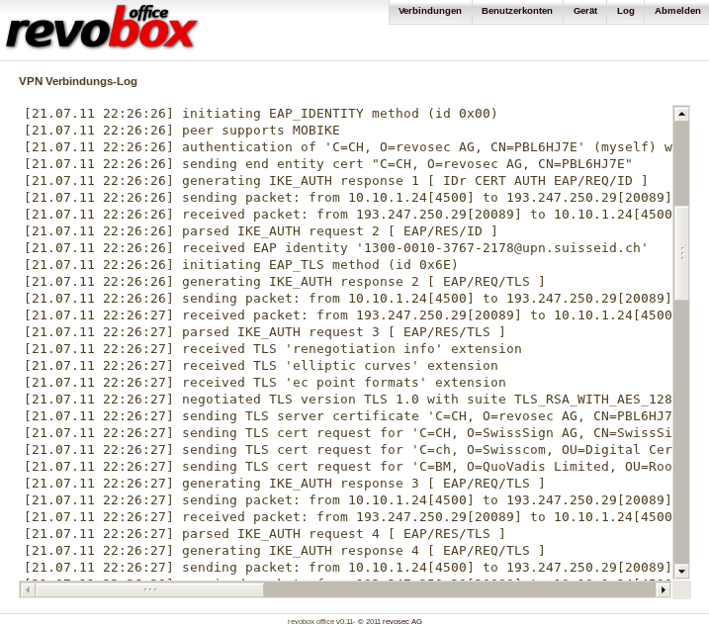
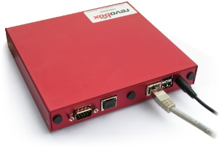
strongSwan SOHO Lösung für Windowsnetze
www.revosec.ch
Notes:
http://www.revosec.ch/en/company

Slide 15
VPN with Mobile Devices revisited
55. DFN Betriebstagung Oktober 2011 Berlin
High Availability mit ClusterIP

Slide 16
strongSwan High-Availability Architektur
Intranet
Plain
Security Gateway 1
Security Gateway 2
HA Sync
Plugin
HA Failover
Plugin
HA Failover
Plugin
HA Sync
Plugin
Socket
Bus IF
Bus IF
Socket
Socket
Bus IF
Bus IF
Socket
Bus IF
Socket
Socket
Bus IF
IKEv2 charon
Daemon
Heartbeat
Daemon
Heartbeat
Daemon
IKEv2 charon
Daemon
IKE/IPsec SA Sync
IKE/IPsec SA Sync
Socket
Kernel IF
Socket
Socket
Kernel IF
Socket
IKE
XFRM
XFRM
IKE
IPsec Policies / IPsec SAs
eth1
eth1
IPsec Policies / IPsec SAs
Linux Netlink
Linux Netlink
eth2
ESP
eth2
ClusterIP
ClusterIP
eth0
eth0
ESP
Internet

Slide 17
Lösungsansatz
Die äusseren eth0 und inneren eth1 Interfaces von SG1 und SG2 teilen sich je eine Phantom IP Adresse mit zugehöriger Multicast MAC Adresse.
Dadurch erhalten beide SGs alle verschlüsselten ESP Pakete auf eth0 und synchronisieren so ständig die Anti-Replay Sequenznummern.
Auf der Basis von ClusterIP (Hash über Source IP und SPI des ESP Packets) entscheidet jeder SG für welche IPsec SAs er zuständig ist.
ClusterIP (Hash über Destination IP und SPI der IPsec SA) wird auch ausgangsseitig auf die Klartextpakete von eth1 angewendet.
Für IKEv2 ist nur ein Master SG zuständig. Alle IKEv2 und ESP Schlüssel werden auf dem Slave SG gespiegelt.
Fällt ein SG aus, übernimmt der andere sofort sämtliche IPsec SAs.
Fällt der Master SG aus, übernimmt sofort der Slave SG sofort die IKEv2 Verbindungen mit quasi-synchronisierten Sequenznummern.

Slide 18
VPN with Mobile Devices revisited
55. DFN Betriebstagung Oktober 2011 Berlin
Trusted Network Connect (TNC) &
Platform Trust Service (PTS)

Slide 19
TNC Policy Enforcement
allow
Policy
Enforcement Point
Corporate Network
TNC Server
block
Host with
TNC Client
isolate
Policy Manager
Remediation
Server
10.1.0.0/16
10.2.0.0/16
Isolation
Network
Source: Jörg Vieweg, FH Hannover

Slide 20
strongSwan Konfiguration auf der PEP Seite
conn rw-allow
rightgroups=allow
leftsubnet=10.1.0.0/16
also=rw-eap
auto=add
conn rw-isolate
rightgroups=isolate
leftsubnet=10.2.0.0/16
also=rw-eap
auto=add
conn rw-eap
left=192.168.0.1
leftcert=moonCert.pem
leftid=@moon.strongswan.org
leftauth=eap-ttls
leftfirewall=yes
rightauth=eap-radius
rightid=*@strongswan.org
rightsendcert=never
right=%any
Notes:
Abbreviations
• AR Access Requestor
• IF Interface
• IMC Integrity Measurement Collector
• IMV Integrity Measurement Verifier
• M Measurement
• PDP Policy Decision Point
• PEP Policy Enforcement Point
• T Transport
• TNC Trusted Network Connect

Slide 21
IF-PEP Protokoll auf dem strongSwan PEP
05[CFG] received RADIUS Access-Accept from server '10.1.0.10'
05[IKE] received RADIUS attribute Tunnel-Type: tag = 0, value = 9
05[IKE] received RADIUS attribute Filter-Id: 'allow'
05[IKE] RADIUS authentication of 'carol@strongswan.org' successful
05[IKE] EAP method EAP_TTLS succeeded, MSK established
05[ENC] generating IKE_AUTH response 11 [ EAP/SUCC ]
05[NET] sending packet: from 192.168.0.1[4500] to 192.168.0.100[4500]
04[NET] received packet: from 192.168.0.100[4500] to 192.168.0.1[4500]
04[ENC] parsed IKE_AUTH request 12 [ AUTH ]
04[IKE] authentication of 'carol@strongswan.org' with EAP successful
04[IKE] authentication of 'moon.strongswan.org' (myself) with EAP
04[IKE] IKE_SA rw-allow[1] established between
192.168.0.1[moon.strongswan.org]...192.168.0.100[carol@strongswan.org]
02[CFG] received RADIUS Access-Accept from server '10.1.0.10'
02[IKE] received RADIUS attribute Tunnel-Type: tag = 0, value = 9
02[IKE] received RADIUS attribute Filter-Id: 'isolate'
02[IKE] RADIUS authentication of 'dave@strongswan.org' successful
02[IKE] EAP method EAP_TTLS succeeded, MSK established
02[ENC] generating IKE_AUTH response 11 [ EAP/SUCC ]
02[NET] sending packet: from 192.168.0.1[4500] to 192.168.0.200[4500]
01[NET] received packet: from 192.168.0.200[4500] to 192.168.0.1[4500]
01[ENC] parsed IKE_AUTH request 12 [ AUTH ]
01[IKE] authentication of 'dave@strongswan.org' with EAP successful
01[CFG] constraint check failed: group membership required
01[CFG] selected peer config 'rw-allow' inacceptable
01[CFG] switching to peer config 'rw-isolate‚
01[IKE] authentication of 'moon.strongswan.org' (myself) with EAP
01[IKE] IKE_SA rw-isolate[2] established between
192.168.0.1[moon.strongswan.org]...192.168.0.200[dave@strongswan.org]
Notes:
Abbreviations
• AR Access Requestor
• IF Interface
• IMC Integrity Measurement Collector
• IMV Integrity Measurement Verifier
• M Measurement
• PDP Policy Decision Point
• PEP Policy Enforcement Point
• T Transport
• TNC Trusted Network Connect

Slide 22
Network Endpoint Assessment (RFC 5209)
NEA Client
NEA Server
Posture
Collectors
(1 .. N)
Posture
Collectors
(1 .. N)
Posture
Collectors
(1 .. N)
Posture
Collectors
(1 .. N)
Posture
Collectors
(1 .. N)
Posture
Validators
(1 .. N)
PA
RFC 5792
PA-TNC
Posture
Broker
Client
Posture
Broker
Server
PB
RFC 5793
PB-TNC
Posture
Transport
Clients
(1 .. K)
Posture
Transport
Clients
(1 .. K)
Posture
Transport
Clients
(1 .. K)
Posture
Transport
Clients
(1 .. K)
Posture
Transport
Clients
(1 .. K)
Posture
Transport
Servers
(1 .. K)
PT
Internet
Drafts
Notes:
Abbreviations
• PA Posture Attribute Protocol
• PB Posture Broker Protocol
• PT Posture Transport Protocol
PA Subtypes
• 0 Testing
• 1 Operating System (OS)
• 2 Anti-Virus
• 3 Anti-Spyware
• 4 Ant-Malware
• 5 Firewall
• 6 Intrusion Detection and/or Prevention (IDPS) Software
• 7 Virtual Private Network (VPN) Software
• 8 NEA Client Software
PT Protocols
• e.g. EAP-TLS via 802.1X (Layer 2) or IKEv2 (Layer 3)

Slide 23
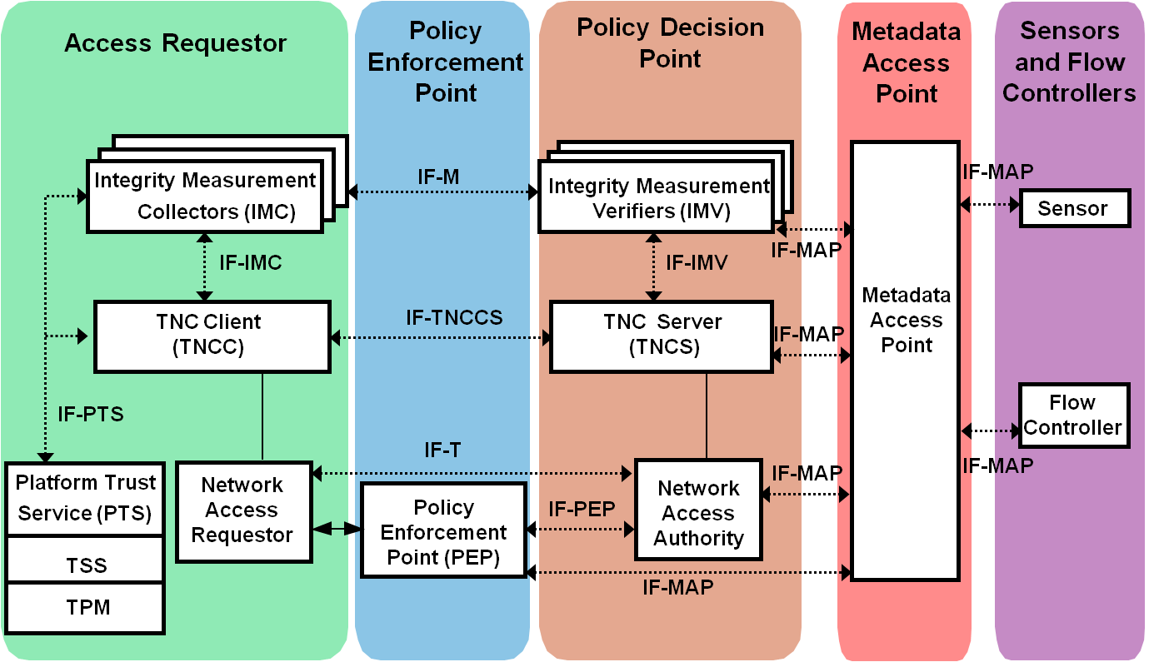



strongSwan als TNC Client und TNC Server
RFC 5792
RFC 5793
Notes:
Abbreviations
• AR Access Requestor
• IF Interface
• IMC Integrity Measurement Collector
• IMV Integrity Measurement Verifier
• M Measurement
• PDP Policy Decision Point
• PEP Policy Enforcement Point
• T Transport
• TNC Trusted Network Connect

Slide 24
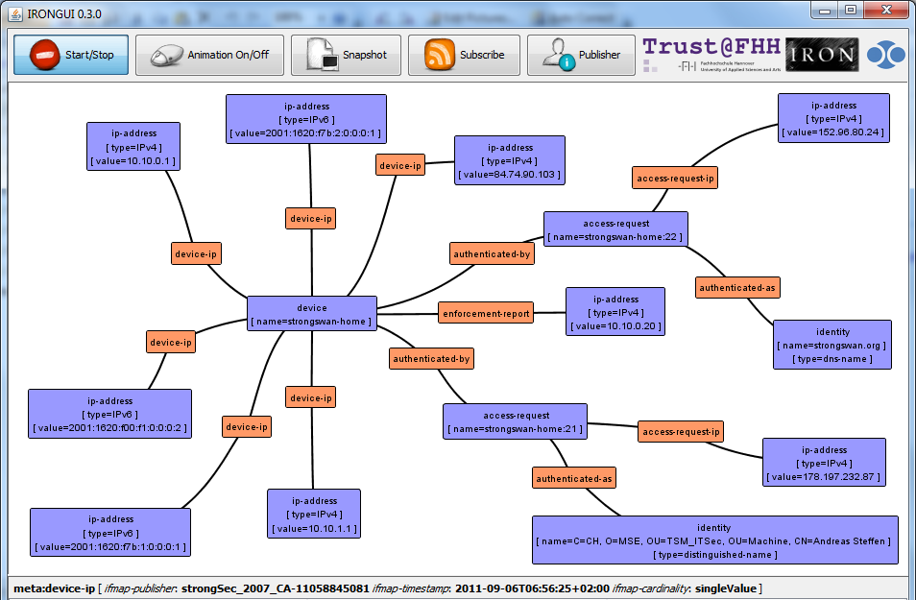
strongSwan als TNC MAP Client
http://trust.inform.fh-hannover.de/
Notes:
Abbreviations
• AR Access Requestor
• IF Interface
• IMC Integrity Measurement Collector
• IMV Integrity Measurement Verifier
• M Measurement
• PDP Policy Decision Point
• PEP Policy Enforcement Point
• T Transport
• TNC Trusted Network Connect

Slide 25


Danke für Ihre
Aufmerksamkeit!
Fragen?
www.strongswan.org

