Slide 1


Mutual Attestation of IoT Devices
TCG Members Meeting June 2015 Edinburgh
Prof. Andreas Steffen
Institute for Internet Technologies and Applications
HSR University of Applied Sciences Rapperswil
andreas.steffen@hsr.ch

Slide 2
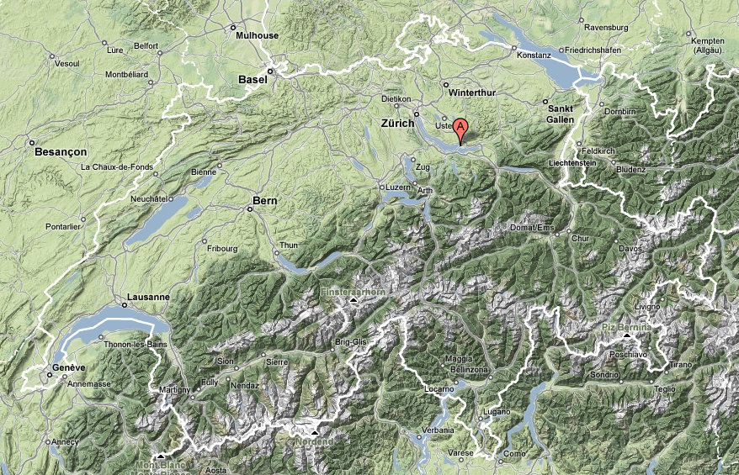


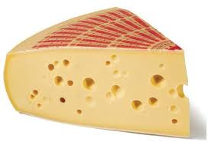


Where the heck is Rapperswil?
HSR

Slide 3
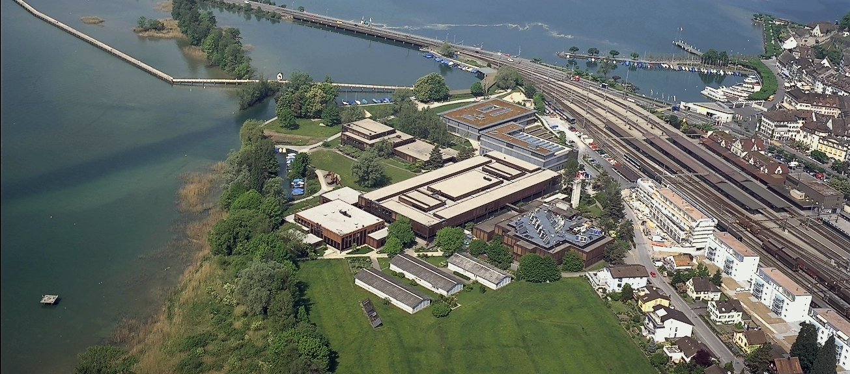

HSR - Hochschule für Technik Rapperswil
University of Applied Sciences with about 1500 students
Faculty of Information Technology (300-400 students)
Bachelor Course (3 years), Master Course (+1.5 years)

Slide 4


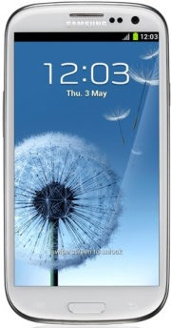
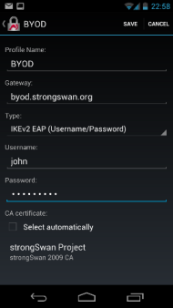

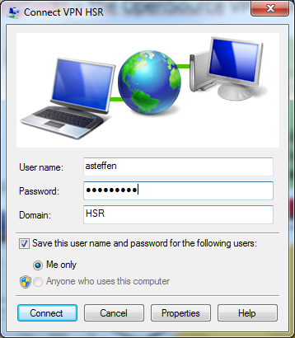
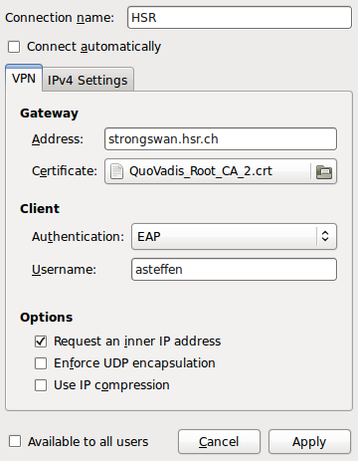




strongSwan – the OpenSource VPN Solution
Windows Active
Directory Server
Linux
FreeRadius Server
Corporate
Network
High-Availability
strongSwan
VPN Gateway
Internet
Windows 7/8
Agile VPN Client
strongSwan
Linux Client
Notes:
N Rekeying Notification (optional)
SA_{i} Suite of cryptographic proposals for the Child SA (ESP and/or AH)
N_{i} Initiator Nonce
KE_{i} Initiatior public factor for the Diffie-Hellman Key Exchange (optional PFS)
TS_{i} Initiator Traffic Selectors (subnets behind the Initiator)
TS_{r} Responder Traffic Selectors (subnets behind the Responder
SA1_{r} Selection of a cryptographic proposal for the IKE SA
N_{r} Responder Nonce
KE_{r} Responder public factor for the Diffie-Hellman Key Exchange (optional PFS)
TS_{i} Initiator Traffic Selectors (subnets behind the Initiator)
TS_{r} Responder Traffic Selectors (subnets behind the Responder

Slide 5
Mutual Attestation of IoT Devices
TCG Members Meeting June 2015 Edinburgh
Trusted Network Communications (TNC)
Current Use Cases:
Network Access Control & Endpoint Compliance

Slide 6
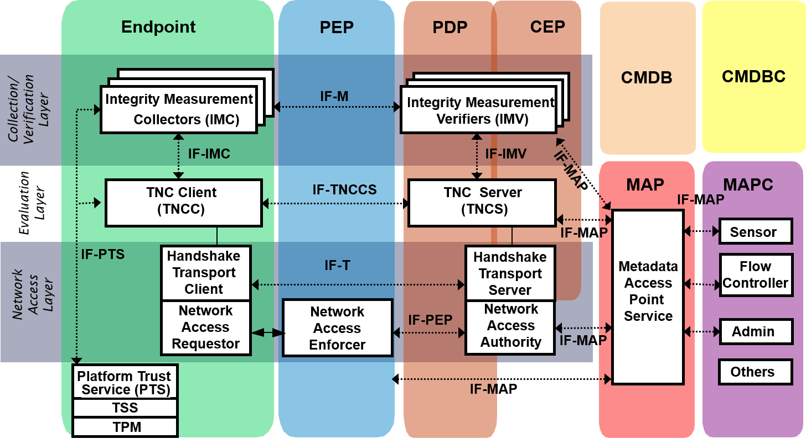
TNC Architecture
RFC 5792
RFC 5793
Endpoint
Compliance
RFC 6876
RFC 7171
VPN Client
VPN Gateway
Lying Endpoint
Network Access Control
Notes:
Abbreviations
• AR Access Requestor
• IF Interface
• IMC Integrity Measurement Collector
• IMV Integrity Measurement Verifier
• M Measurement
• PDP Policy Decision Point
• PEP Policy Enforcement Point
• T Transport
• TNC Trusted Network Connect

Slide 7
Network Endpoint Assessment (RFC 5209)
NEA Client
NEA Server
Posture
Collectors
(1 .. N)
Posture
Collectors
(1 .. N)
Posture
Collectors
(1 .. N)
Posture
Collectors
(1 .. N)
Posture
Collectors
(1 .. N)
Posture
Validators
(1 .. N)
PA
RFC 5792
PA-TNC
Posture
Broker
Client
Posture
Broker
Server
PB
RFC 5793
PB-TNC
Posture
Transport
Clients
(1 .. K)
Posture
Transport
Clients
(1 .. K)
Posture
Transport
Clients
(1 .. K)
Posture
Transport
Clients
(1 .. K)
Posture
Transport
Clients
(1 .. K)
Posture
Transport
Servers
(1 .. K)
PT
RFC 6876 PT-TLS
RFC 7171 PT-EAP
Notes:
Abbreviations
• PA Posture Attribute Protocol
• PB Posture Broker Protocol
• PT Posture Transport Protocol
PA Subtypes
• 0 Testing
• 1 Operating System (OS)
• 2 Anti-Virus
• 3 Anti-Spyware
• 4 Ant-Malware
• 5 Firewall
• 6 Intrusion Detection and/or Prevention (IDPS) Software
• 7 Virtual Private Network (VPN) Software
• 8 NEA Client Software
PT Protocols
• e.g. EAP-TLS via 802.1X (Layer 2) or IKEv2 (Layer 3)

Slide 8
Layered TNC Protocol Stack
TNC Measurement Data
[IMV] operating system name is 'Android' from vendor Google
[IMV] operating system version is '4.2.1‘
[IMV] device ID is cf5e4cbcc6e6a2db
IF-M Measurement Protocol PA-TNC (RFC 5792)
[TNC] handling PB-PA message type 'IETF/Operating System' 0x000000/0x00000001
[IMV] IMV 1 "OS" received message for Connection ID 1 from IMC 1
[TNC] processing PA-TNC message with ID 0xec41ce1d
[TNC] processing PA-TNC attribute type 'IETF/Product Information' 0x000000/0x00000002
[TNC] processing PA-TNC attribute type 'IETF/String Version' 0x000000/0x00000004
[TNC} processing PA-TNC attribute type 'ITA-HSR/Device ID' 0x00902a/0x00000008
IF-TNCCS TNC Client-Server Protocol PB-TNC (RFC 5793)
[TNC] received TNCCS batch (160 bytes) for Connection ID 1
[TNC] PB-TNC state transition from 'Init' to 'Server Working'
[TNC] processing PB-TNC CDATA batch
[TNC] processing PB-Language-Preference message (31 bytes)
[TNC] processing PB-PA message (121 bytes)
[TNC] setting language preference to 'en‘
IF-T Transport Protocol PT-EAP (RFC 7171)
[NET] received packet: from 152.96.15.29[50871] to 77.56.144.51[4500] (320 bytes)
[ENC] parsed IKE_AUTH request 8 [ EAP/RES/TTLS ]
[IKE] received tunneled EAP-TTLS AVP [EAP/RES/PT]

Slide 9
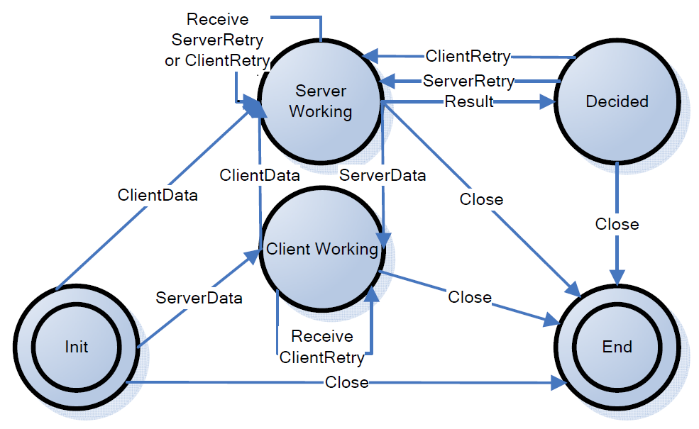
PB-TNC / IF-TNCCS 2.0 State Machine
Exchange of PB-TNC Client/Server Data Batches containing PA-TNC Messages
Notes:
PA-TNC IF-TNCCS 2.0 Batch Types
• CDATA ClientData
• SDATA ServerData
• CRETRY ClientRetry
• SRETRY ServerRetry
• RESULT Result
• CLOSE Close

Slide 10
Mutual Attestation of IoT Devices
TCG Members Meeting June 2015 Edinburgh
Trusted Network Communications (TNC)
New Use Case:
Mutual Measurements of Endpoints

Slide 11

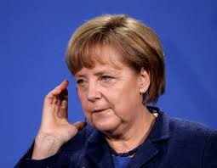
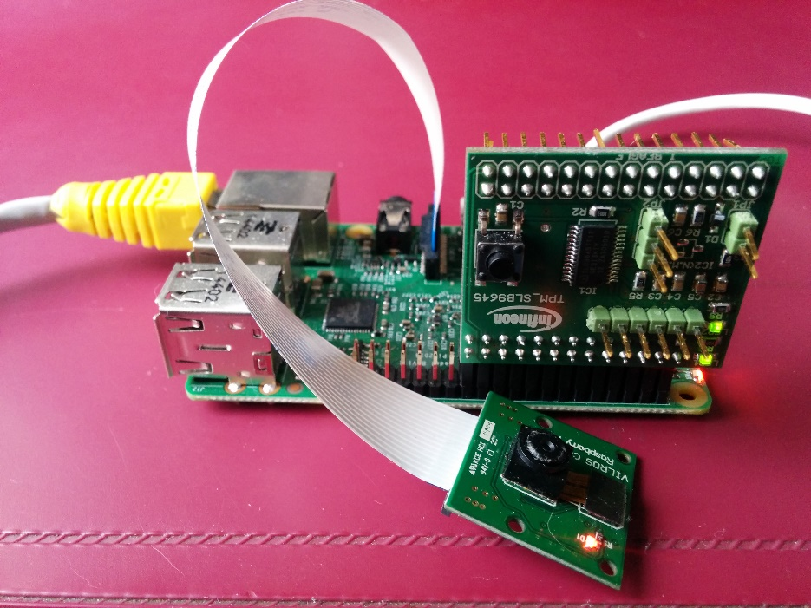
Example: Mutually Trusted Video Phones
Notes:
PA-TNC IF-TNCCS 2.0 Batch Types
• CDATA ClientData
• SDATA ServerData
• CRETRY ClientRetry
• SRETRY ServerRetry
• RESULT Result
• CLOSE Close

Slide 12

Mutual Attestation of IoT Devices
DB
DB
DB
Trusted Reference DB
TLS
TLS
DB
DB
Attestation IMV
Attestation IMV
TNC Server
TNC Server
PT-EAP
PT-EAP
TNC Client
TNC Client
OS IMC
Attestation IMC
IKEv2
Attestation IMC
OS IMC
Linux OS
TPM
TPM
Linux OS
Linux IMA*
IPsec
Linux IMA
IoT Device 1
Video Link
Video Link
IoT Device 2
* IMA: Integrity Measurement Architecture
Notes:
PA-TNC IF-TNCCS 2.0 Batch Types
• CDATA ClientData
• SDATA ServerData
• CRETRY ClientRetry
• SRETRY ServerRetry
• RESULT Result
• CLOSE Close

Slide 13
Why do Mutual TNC Measurements work?
Definition of PB-TNC Batch Header in RFC 5793
0 1 2 3
0 1 2 3 4 5 6 7 8 9 0 1 2 3 4 5 6 7 8 9 0 1 2 3 4 5 6 7 8 9 0 1
+-+-+-+-+-+-+-+-+-+-+-+-+-+-+-+-+-+-+-+-+-+-+-+-+-+-+-+-+-+-+-+-+
| Version |D| Reserved | B-Type|
+-+-+-+-+-+-+-+-+-+-+-+-+-+-+-+-+-+-+-+-+-+-+-+-+-+-+-+-+-+-+-+-+
| Batch Length |
+-+-+-+-+-+-+-+-+-+-+-+-+-+-+-+-+-+-+-+-+-+-+-+-+-+-+-+-+-+-+-+-+
Directionality (D) (1 bit)
When a Posture Broker Client is sending this message, the
Directionality bit MUST be set to 0.
When a Posture Broker Server is sending this message, the
Directionality bit MUST be set to 1.
This helps avoid any situation where two Posture Broker Clients
or two Posture Broker Servers engage in a dialog. It also helps
with debugging.
Idea: Use the Directionality Flag to multiplex two IF-TNCCS 2.0 connections in opposite directions over a common IF-T transport channel.

Slide 14
PB-TNC Mutual Capability Announcement
PB-Mutual-Capability Message defined in ITA-HSR Namespace
0 1 2 3
0 1 2 3 4 5 6 7 8 9 0 1 2 3 4 5 6 7 8 9 0 1 2 3 4 5 6 7 8 9 0 1
+-+-+-+-+-+-+-+-+-+-+-+-+-+-+-+-+-+-+-+-+-+-+-+-+-+-+-+-+-+-+-+-+
| Flags | PB-TNC Vendor ID |
+-+-+-+-+-+-+-+-+-+-+-+-+-+-+-+-+-+-+-+-+-+-+-+-+-+-+-+-+-+-+-+-+
| PB-TNC Message Type |
+-+-+-+-+-+-+-+-+-+-+-+-+-+-+-+-+-+-+-+-+-+-+-+-+-+-+-+-+-+-+-+-+
| PB-TNC Message Length |
+-+-+-+-+-+-+-+-+-+-+-+-+-+-+-+-+-+-+-+-+-+-+-+-+-+-+-+-+-+-+-+-+
|H|F| Reserved |
+-+-+-+-+-+-+-+-+-+-+-+-+-+-+-+-+-+-+-+-+-+-+-+-+-+-+-+-+-+-+-+-+
PB-TNC Vendor ID (24 bits)
0x00902A (ITA-HSR)
PB-TNC Message Type (32 bits)
0x00000001 (PB-Mutual-Capability)
PB-TNC Message Type (32 bits)
16 (bytes)
Half-Duplex Capability (H) (1 bit)
Full-Duplex Capability (F) (1 bit)
.

Slide 15
Mutual Measurements in Half-Duplex Mode
Initiator |  | PB-TNC Batch[PB-TNC Messages] |  | Responder
TNC Client | → | CDATA[PB-MUTUAL, PB-PA] | → | TNC Server
TNC Client | ← | SDATA[PB-MUTUAL, PB-PA] | ← | TNC Server
TNC Server | → | SDATA[] | → | TNC Client
TNC Server | ← | CDATA[PB-PA] | ← | TNC Client
TNC Client | → | CDATA[PB-PA] | → | TNC Server
TNC Client | ← | RESULT[PB-ASSESSMENT] | ← | TNC Server
TNC Server | → | SDATA[PB-PA] | → | TNC Client
TNC Server | ← | CDATA[PB-PA] | ← | TNC Client
TNC Server | → | RESULT[PB-ASSESSMENT] | → | TNC Client
TNC Server | ← | CLOSE[] | ← | TNC Client
TNC Client | → | CLOSE[] | → | TNC Server
The initiating TNC client sends CLOSE batch last
Works over PT-EAP and PT-TLS

Slide 16
Mutual Measurements in Full-Duplex Mode
Initiator |  | PB-TNC Batch[PB-TNC Messages] |  | Responder
TNC Client | → | CDATA[PB-MUTUAL, PB-PA] | → | TNC Server
TNC Client | ← | SDATA[PB-MUTUAL, PB-PA] | ← | TNC Server
TNC Server | ← | CDATA[PB-PA] | ← | TNC Client
TNC Client | → | CDATA[PB-PA] | → | TNC Server
TNC Server | → | SDATA[PB-PA] | → | TNC Client
TNC Client | ← | RESULT[PB-ASSESSMENT] | ← | TNC Server
TNC Server | ← | CDATA[PB-PA] | ← | TNC Client
TNC Server | → | RESULT[PB-ASSESSMENT] | → | TNC Client
TNC Server | ← | CLOSE[] | ← | TNC Client
TNC Client | → | CLOSE[] | → | TNC Server
The initiating TNC client sends CLOSE batch last
Works over PT-TLS only

Slide 17
Conclusions
Mutual TNC measurements can be easily implemented without changes in the existing PB-TNC IETF standard.
The announcement of the mutual TNC measurement capability is done via a PB-Mutual-Capability PB-TNC message currently defined in the ITA-HSR namespace.
If the mutual TNC measurement capability is of general interest then the announcement message should be standardized either in
the TCG or IETF namespace.
Another interesting use case for the mutual measurement capability would be an initiating endpoint wanting to attest a cloud server before connecting to it.

Slide 18


Thank you for
your attention!
Questions?
www.strongswan.org/tnc/

