Slide 1


Linux Kongress 2009 Dresden
IKEv2-based VPNs using strongSwan
Prof. Dr. Andreas Steffen
andreas.steffen@strongswan.org

Slide 2
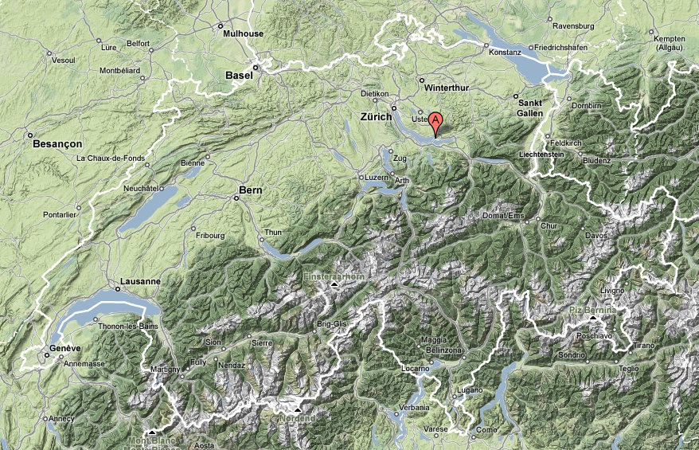
Where the heck is Rapperswil?

Slide 3
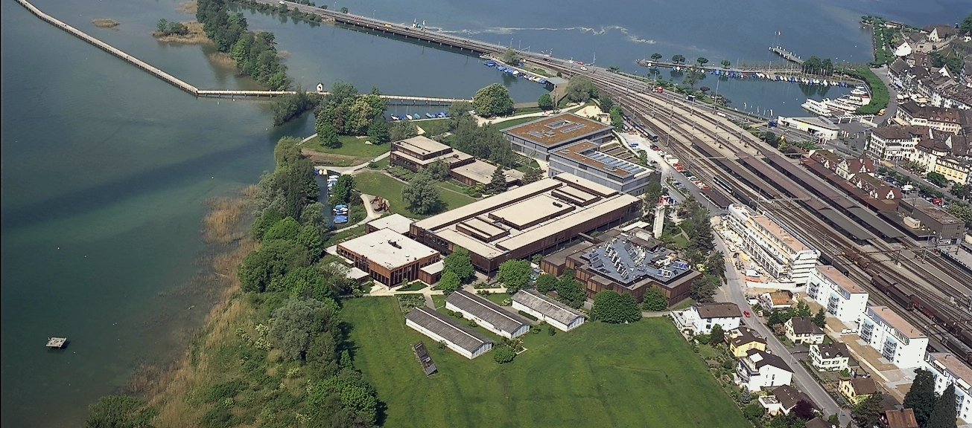

HSR - Hochschule für Technik Rapperswil
University of Applied Sciences with about 1000 students
Faculty of Information Technology (300-400 students)
Bachelor Course (3 years), Master Course (+1.5 years)

Slide 4
Agenda
What is strongSwan?
IKEv1 versus IKEv2
A Simple Remote Access Example
Virtual IP Pools
Certificate Revocation Mechanisms
The NETKEY IPsec Stack of the Linux 2.6 Kernel
Interaction with the Linux Netfilter Firewall
Dead Peer Detection (DPD)
Remote Access with Mixed Authentication
Interoperability with the Windows 7 Agile VPN Client
The strongSwan NetworkManager Plugin
EAP-Radius based Authentication
The strongSwan Architecture
Cryptographic Plugins
High Availability using Cluster IP
IKEv2 Mediation Extension

Slide 5
Linux Kongress 2009 Dresden
What is strongSwan?

Slide 6
VPN Usage Scenarios
„Road Warrior“
VPN Client
10.3.0.2
10.1.0.5
10.2.0.3
55.66.x.x
Internet
VPN Tunnel
Head
Quarters
VPN Tunnel
Subsidiary
10.1.0.0/16
VPN Gateway
11.22.33.44
VPN Gateway
55.66.77.88
10.2.0.0/16
strongSwan is an Internet Key Exchange daemon needed to automatically set up IPsec-based VPN connections.

Slide 7
The FreeS/WAN Genealogy
1999
FreeS/WAN 1.x
2000
X.509 1.x Patch
FreeS/WAN 2.x
 2004
Super FreeS/WAN
2003
X.509 2.x Patch
Openswan 1.x
2004
Openswan 2.x
strongSwan 2.x
2005
ITA IKEv2 Project
2006
2007
strongSwan 4.x
Openswan 2.6.x
IKEv1 & IKEv2
IKEv1 &
partial IKEv2

Slide 8
The strongSwan IKE Daemons
IKEv1
ipsec.conf
IKEv2
ipsec
whack
ipsec
starter
ipsec
stroke
IKEv1
- 6 messages for IKE SA
Phase 1 Main Mode
- 3 messages for IPsec SA
Phase 2 Quick Mode
IKEv2
- 4 messages for IKE SA
and first IPsec SA
IKE_SA_INIT/IKE_AUTH
- 2 messages for each
additional IPsec SA
CREATE_CHILD_SA
whack socket
stroke socket
pluto
charon
Netlink
XFRM
socket
Linux 2.6
kernel
LSF
UDP/500
socket
native
IPsec
raw
socket

Slide 9
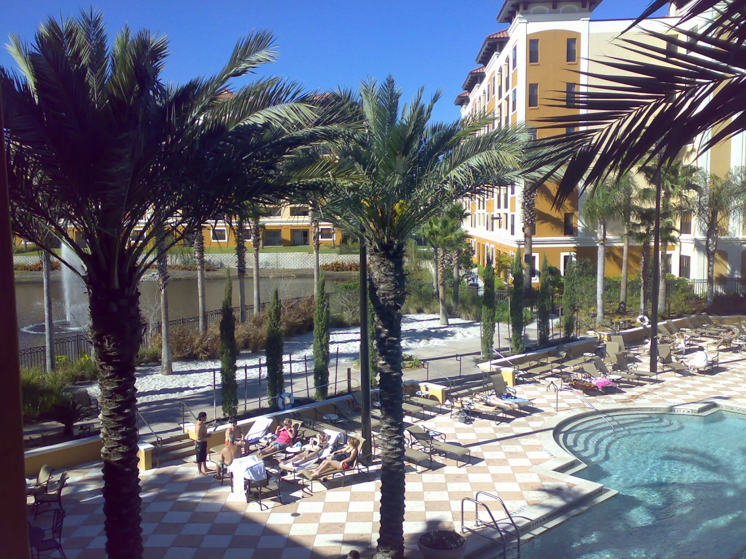
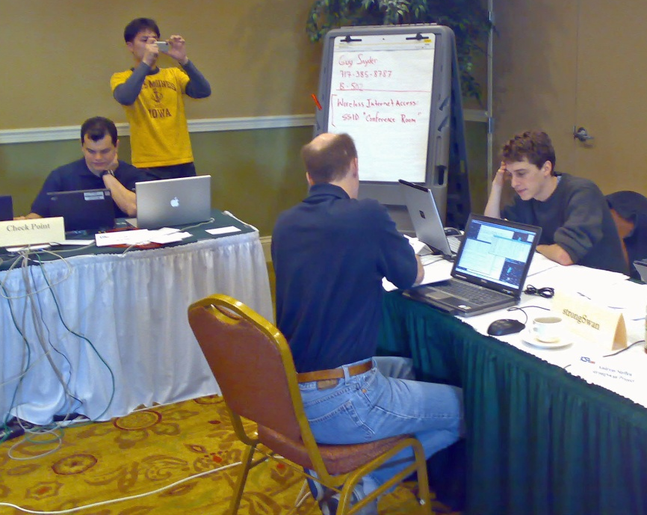
IKEv2 Interoperability Workshops
Spring 2007 in Orlando, Florida
Spring 2008 in San Antonio, Texas
strongSwan successfully interoperated with IKEv2 products from
Alcatel-Lucent, Certicom, CheckPoint, Cisco, Furukawa, IBM, Ixia,
Juniper, Microsoft, Nokia, SafeNet, Secure Computing, SonicWall,
and the IPv6 TAHI Project.

Slide 10
Linux Kongress 2009 Dresden
IVEv1 versus IKEv2

Slide 11
Internet Key Exchange – IKEv1 Main Mode
Initiator
UDP/500
Responder
IKE
Header
ISAKMP SA
Proposal
1
IKE
Header
ISAKMP SA
Response
2
IKE
Header
DH Key
Exchange
N_{i}
3
IKE
Header
DH Key
Exchange
N_{r}
4
encrypted
IKE
Header
ID_{i}
Cert_{i}
Sig_{i}
5
encrypted
IKE
Header
ID_{r}
Cert_{r}
Sig_{r}
6
IKEv1 Quick Mode – another three
messages to negotiate traffic selectors

Slide 12
IKEv2 – Authentication and first Child SA
Initiator
UDP/500
Responder
IKE
Header
SA1_{i}
KE_{i}
N_{i}
1
IKE
Header
SA1_{r}
KE_{r}
N_{r}
2
IKE_SA_INIT exchange pair
IKE
Header
ID_{i}
Cert_{i}
ID_{r}
3
Auth_{i}
SA2_{i}
TS_{i}
TS_{r}
encrypted
IKE
Header
ID_{r}
Cert_{r}
Auth_{r}
4
SA2_{r}
TS_{i}
TS_{r}
IKE_AUTH exchange pair
encrypted
Notes:
SA1_{i} Suite of cryptographic proposals for the IKE SA
KE_{i} Initiatior public factor for the Diffie-Hellman Key Exchange
N_{i} Initiator Nonce
SA1_{r} Selection of a cryptographic proposal for the IKE SA
KE_{r} Responder public factor for the Diffie-Hellman Key Exchange
N_{r} Responder Nonce
ID_{i} Initiator ID
Cert_{i} Initiator Certificate (optional)
ID_{r} Desired Responder ID (optional)
Auth_{i} Initiator Authentication (RSA, PSK, or EAP)
SA2_{i} Suite of cryptographic proposals for the Child SA (ESP and/or AH)
TS_{i} Initiator Traffic Selectors (subnets behind the Initiator)
TS_{r} Responder Traffic Selectors (subnets behind the Responder)
ID_{r} Responder ID
Cert_{r} Responder Certificate (optional)
Auth_{r} Responder Authentication (RSA, PSK, or EAP)
SA2_{r} Selection of a cryptographic proposal for the Child SA (ESP and/or AH)
TS_{i} Initiator Traffic Selectors (subnets behind the Initiator, optional narrowing)
TS_{r} Responder Traffic Selectors (subnets behind the Responder, optional narrowing)

Slide 13
IKEv2 – Additional Child SAs
Initiator
UDP/500
Responder
IKE
Header
N
SA_{i}
N_{i}
1
KE_{i}
TS_{i}
TS_{r}
encrypted
IKE
Header
SA_{r}
N_{r}
2
KE_{r}
TS_{i}
TS_{r}
CREATE_CHILD_SA exchange pair
encrypted
Notes:
N Rekeying Notification (optional)
SA_{i} Suite of cryptographic proposals for the Child SA (ESP and/or AH)
N_{i} Initiator Nonce
KE_{i} Initiatior public factor for the Diffie-Hellman Key Exchange (optional PFS)
TS_{i} Initiator Traffic Selectors (subnets behind the Initiator)
TS_{r} Responder Traffic Selectors (subnets behind the Responder
SA1_{r} Selection of a cryptographic proposal for the IKE SA
N_{r} Responder Nonce
KE_{r} Responder public factor for the Diffie-Hellman Key Exchange (optional PFS)
TS_{i} Initiator Traffic Selectors (subnets behind the Initiator)
TS_{r} Responder Traffic Selectors (subnets behind the Responder

Slide 14
Linux Kongress 2009 Dresden
A Simple
Remote Access Example

Slide 15
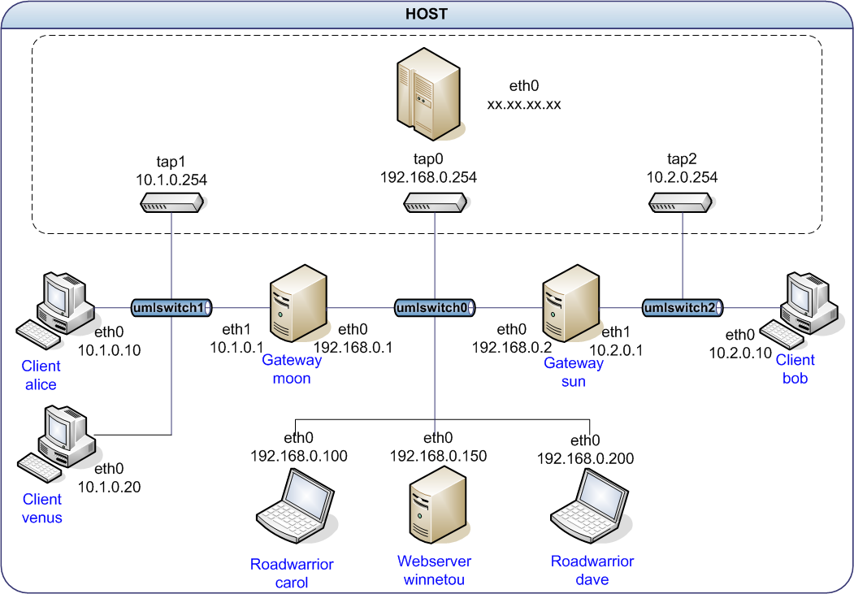
User-Mode-Linux VPN Testbed
Notes:
N Rekeying Notification (optional)
SA_{i} Suite of cryptographic proposals for the Child SA (ESP and/or AH)
N_{i} Initiator Nonce
KE_{i} Initiatior public factor for the Diffie-Hellman Key Exchange (optional PFS)
TS_{i} Initiator Traffic Selectors (subnets behind the Initiator)
TS_{r} Responder Traffic Selectors (subnets behind the Responder
SA1_{r} Selection of a cryptographic proposal for the IKE SA
N_{r} Responder Nonce
KE_{r} Responder public factor for the Diffie-Hellman Key Exchange (optional PFS)
TS_{i} Initiator Traffic Selectors (subnets behind the Initiator)
TS_{r} Responder Traffic Selectors (subnets behind the Responder

Slide 16
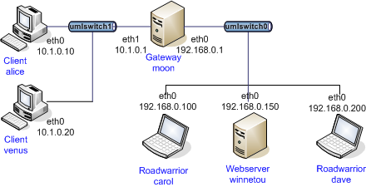
IKEv2 Remote Access Scenario
#ipsec.secrets for roadwarrior carol
: RSA carolKey.pem "nH5ZQEWtku0RJEZ6"
#ipsec.secrets for gateway moon
: RSA moonKey.pem
#ipsec.conf for roadwarrior carol
conn home
keyexchange=ikev2
left=%defaultroute
leftsourceip=%config
leftcert=carolCert.pem
leftid=carol@strongswan.org
leftfirewall=yes
right=192.168.0.1
rightid=@moon.strongswan.org
rightsubnet=10.1.0.0/16
auto=start
#ipsec.conf for gateway moon
config setup
plutostart=no #IKEv1 not needed
conn rw
keyexchange=ikev2
left=%any
leftsubnet=10.1.0.0/24
leftcert=moonCert.pem
leftid=@moon.strongswan.org
leftfirewall=yes
right=%any
rightsourceip=10.3.0.0/24
auto=add
Notes:
N Rekeying Notification (optional)
SA_{i} Suite of cryptographic proposals for the Child SA (ESP and/or AH)
N_{i} Initiator Nonce
KE_{i} Initiatior public factor for the Diffie-Hellman Key Exchange (optional PFS)
TS_{i} Initiator Traffic Selectors (subnets behind the Initiator)
TS_{r} Responder Traffic Selectors (subnets behind the Responder
SA1_{r} Selection of a cryptographic proposal for the IKE SA
N_{r} Responder Nonce
KE_{r} Responder public factor for the Diffie-Hellman Key Exchange (optional PFS)
TS_{i} Initiator Traffic Selectors (subnets behind the Initiator)
TS_{r} Responder Traffic Selectors (subnets behind the Responder

Slide 17
IKEv2 Connection Setup
carol
05[ENC] generating IKE_SA_INIT request [SA KE No N(NATD_S_IP) N(NATD_D_IP)]
05[NET] sending packet: from 192.168.0.100[500] to 192.168.0.1[500]
06[NET] received packet: from 192.168.0.1[500] to 192.168.0.100[500]
06[ENC] parsed IKE_SA_INIT response [SA KE No N(NATD_S_IP) N(NATD_D_IP) CERTREQ]
06[ENC] generating IKE_AUTH request [IDi CERT CERTREQ IDr AUTH CP SA TSi TSr]
06[NET] sending packet: from 192.168.0.100[500] to 192.168.0.1[500]
07[NET] received packet: from 192.168.0.1[500] to 192.168.0.100[500]
07[ENC] parsed IKE_AUTH response [IDr CERT AUTH CP SA TSi TSr N(AUTH_LFT)]
07[IKE] installing new virtual IP 10.3.0.1
07[AUD] established CHILD_SA successfully
moon
05[NET] received packet: from 192.168.0.100[500] to 192.168.0.1[500]
05[ENC] parsed IKE_SA_INIT request [SA KE No N(NATD_S_IP) N(NATD_D_IP)]
05[ENC] generating IKE_SA_INIT response [SA KE No N(NATD_S_IP) N(NATD_D_IP) CERTREQ]
05[NET] sending packet: from 192.168.0.1[500] to 192.168.0.100[500]
06[NET] received packet: from 192.168.0.100[500] to 192.168.0.1[500]
06[ENC] parsed IKE_AUTH request [IDi CERT CERTREQ IDr AUTH CP SA TSi TSr]
06[IKE] peer requested virtual IP %any
06[IKE] assigning virtual IP 10.3.0.1 to peer
06[AUD] established CHILD_SA successfully
06[ENC] generating IKE_AUTH response [IDr CERT AUTH CP SA TSi TSr N(AUTH_LFT)]
06[NET] sending packet: from 192.168.0.1[500] to 192.168.0.100[500]
No port floating to 4500 with mobike=no
Notes:
N Rekeying Notification (optional)
SA_{i} Suite of cryptographic proposals for the Child SA (ESP and/or AH)
N_{i} Initiator Nonce
KE_{i} Initiatior public factor for the Diffie-Hellman Key Exchange (optional PFS)
TS_{i} Initiator Traffic Selectors (subnets behind the Initiator)
TS_{r} Responder Traffic Selectors (subnets behind the Responder
SA1_{r} Selection of a cryptographic proposal for the IKE SA
N_{r} Responder Nonce
KE_{r} Responder public factor for the Diffie-Hellman Key Exchange (optional PFS)
TS_{i} Initiator Traffic Selectors (subnets behind the Initiator)
TS_{r} Responder Traffic Selectors (subnets behind the Responder

Slide 18
IKEv2 Connection Setup with MOBIKE
carol
05[ENC] generating IKE_SA_INIT request [SA KE No N(NATD_S_IP) N(NATD_D_IP)]
05[NET] sending packet: from 192.168.0.100[500] to 192.168.0.1[500]
06[NET] received packet: from 192.168.0.1[500] to 192.168.0.100[500]
06[ENC] parsed IKE_SA_INIT response [SA KE No N(NATD_S_IP) N(NATD_D_IP) CERTREQ]
06[ENC] generating IKE_AUTH request [IDi .. N(MOBIKE_SUP) N(ADD_6_ADDR)]
06[NET] sending packet: from 192.168.0.100[4500] to 192.168.0.1[4500]
07[NET] received packet: from 192.168.0.1[4500] to 192.168.0.100[4500]
07[ENC] parsed IKE_AUTH response [IDr .. N(MOBIKE_SUP) N(ADD_4_ADDR) N(ADD_6_ADDR)+]
07[IKE] installing new virtual IP 10.3.0.1
07[AUD] established CHILD_SA successfully
moon
05[NET] received packet: from 192.168.0.100[500] to 192.168.0.1[500]
05[ENC] parsed IKE_SA_INIT request [SA KE No N(NATD_S_IP) N(NATD_D_IP)]
05[ENC] generating IKE_SA_INIT response [SA KE No N(NATD_S_IP) N(NATD_D_IP) CERTREQ]
05[NET] sending packet: from 192.168.0.1[500] to 192.168.0.100[500]
06[NET] received packet: from 192.168.0.100[4500] to 192.168.0.1[4500]
06[ENC] parsed IKE_AUTH request [IDi .. N(MOBIKE_SUP) N(ADD_6_ADDR)]
06[IKE] peer requested virtual IP %any
06[IKE] assigning virtual IP 10.3.0.1 to peer
06[AUD] established CHILD_SA successfully
06[ENC] generating IKE_AUTH resp [IDr .. N(MOBIKE_SUP) N(ADD_4_ADDR) N(ADD_6_ADDR)+]
06[NET] sending packet: from 192.168.0.1[4500] to 192.168.0.100[4500]
Port floating to 4500 by default
Notes:
N Rekeying Notification (optional)
SA_{i} Suite of cryptographic proposals for the Child SA (ESP and/or AH)
N_{i} Initiator Nonce
KE_{i} Initiatior public factor for the Diffie-Hellman Key Exchange (optional PFS)
TS_{i} Initiator Traffic Selectors (subnets behind the Initiator)
TS_{r} Responder Traffic Selectors (subnets behind the Responder
SA1_{r} Selection of a cryptographic proposal for the IKE SA
N_{r} Responder Nonce
KE_{r} Responder public factor for the Diffie-Hellman Key Exchange (optional PFS)
TS_{i} Initiator Traffic Selectors (subnets behind the Initiator)
TS_{r} Responder Traffic Selectors (subnets behind the Responder

Slide 19
Narrowing Traffic Selectors
carol
carol> ipsec statusall
Connections:
home: 192.168.0.100...192.168.0.1
home: local: [carol@strongswan.org] uses public key authentication
home: cert: "C=CH, O=Linux strongSwan, OU=Research, CN=carol@strongswan.org"
home: remote: [moon.strongswan.org] uses any authentication
home: child: dynamic === 10.1.0.0/16
Security Associations:
home[1]: ESTABLISHED 14 seconds ago, 192.168.0.100[carol@strongswan.org]...
192.168.0.1[moon.strongswan.org]
home[1]: IKE SPIs: 23b9b14113e91e86_i* 0315c61d96ef0a4f_r, reauth. in 2 hours
home[1]: IKE proposal: AES_CBC_128/HMAC_SHA1_96/PRF_HMAC_SHA1/MODP_2048
home{1}: INSTALLED, TUNNEL, ESP SPIs: cb342ccc_i c9d6623b_o
home{1}: AES_CBC_128/HMAC_SHA1_96, 84 bytes_i (10s ago), 84 bytes_o (10s ago),
home{1}: 10.3.0.1/32 === 10.1.0.0/24
In the most extreme case the remote access client just proposes the widest possible traffic selector of 0.0.0.0/0 and lets the VPN gateway decide which networks and protocols to grant access to.
Notes:
N Rekeying Notification (optional)
SA_{i} Suite of cryptographic proposals for the Child SA (ESP and/or AH)
N_{i} Initiator Nonce
KE_{i} Initiatior public factor for the Diffie-Hellman Key Exchange (optional PFS)
TS_{i} Initiator Traffic Selectors (subnets behind the Initiator)
TS_{r} Responder Traffic Selectors (subnets behind the Responder
SA1_{r} Selection of a cryptographic proposal for the IKE SA
N_{r} Responder Nonce
KE_{r} Responder public factor for the Diffie-Hellman Key Exchange (optional PFS)
TS_{i} Initiator Traffic Selectors (subnets behind the Initiator)
TS_{r} Responder Traffic Selectors (subnets behind the Responder

Slide 20
IKEv2 Configuration Payload
carol
carol> ip addr list dev eth0
eth0: inet 192.168.0.100/24 brd 192.168.0.255 scope global eth0
inet 10.3.0.1/32 scope global eth0
carol> ip route list table 220
10.1.0.0/24 dev eth0 proto static src 10.3.0.1
A virtual IP requested and obtained through leftsourceip=%config
is directly configured by strongSwan via the RT Netlink socket
moon
moon> ip addr list
eth0: inet 192.168.0.1/24 brd 192.168.0.255 scope global eth0
eth1: inet 10.1.0.1/16 brd 10.1.255.255 scope global eth1
moon> ip route list table 220
10.3.0.1 dev eth0 proto static src 10.1.0.1
If a host has an internal interface which is part of the negotiated traffic selectors then this source address is assigned to tunneled IP packets.
Notes:
N Rekeying Notification (optional)
SA_{i} Suite of cryptographic proposals for the Child SA (ESP and/or AH)
N_{i} Initiator Nonce
KE_{i} Initiatior public factor for the Diffie-Hellman Key Exchange (optional PFS)
TS_{i} Initiator Traffic Selectors (subnets behind the Initiator)
TS_{r} Responder Traffic Selectors (subnets behind the Responder
SA1_{r} Selection of a cryptographic proposal for the IKE SA
N_{r} Responder Nonce
KE_{r} Responder public factor for the Diffie-Hellman Key Exchange (optional PFS)
TS_{i} Initiator Traffic Selectors (subnets behind the Initiator)
TS_{r} Responder Traffic Selectors (subnets behind the Responder

Slide 21
Linux Kongress 2009 Dresden
Virtual IP Address Pools

Slide 22
Volatile RAM-based IP Address Pools
Configuration in ipsec.conf
conn rw
keyexchange=ikev2
...
rightsourceip=10.3.0.0/24
auto=add
Statistics
ipsec leases
Leases in pool 'rw', usage: 2/255, 2 online
10.3.0.2 online 'dave@strongswan.org'
10.3.0.1 online 'carol@strongswan.org'
Referencing and sharing a volatile pool
conn rw1
keyexchange=ikev2
...
rightsourceip=%rw
auto=add
Notes:
N Rekeying Notification (optional)
SA_{i} Suite of cryptographic proposals for the Child SA (ESP and/or AH)
N_{i} Initiator Nonce
KE_{i} Initiatior public factor for the Diffie-Hellman Key Exchange (optional PFS)
TS_{i} Initiator Traffic Selectors (subnets behind the Initiator)
TS_{r} Responder Traffic Selectors (subnets behind the Responder
SA1_{r} Selection of a cryptographic proposal for the IKE SA
N_{r} Responder Nonce
KE_{r} Responder public factor for the Diffie-Hellman Key Exchange (optional PFS)
TS_{i} Initiator Traffic Selectors (subnets behind the Initiator)
TS_{r} Responder Traffic Selectors (subnets behind the Responder

Slide 23
Persistant SQL-based IP Address Pools I
SQLite database table definitions
http://wiki.strongswan.org/repositories/entry/strongswan/
testing/hosts/default/etc/ipsec.d/tables.sql
Creation of SQLite database
cat /etc/ipsec.d/table.sql | sqlite3 /etc/ipsec.d/ipsec.db
Connecting to the SQLite database
# /etc/strongswan.conf - strongSwan configuration file
libstrongswan {
plugins {
attr-sql {
database = sqlite:///etc/ipsec.d/ipsec.db
}
}
}
Notes:
N Rekeying Notification (optional)
SA_{i} Suite of cryptographic proposals for the Child SA (ESP and/or AH)
N_{i} Initiator Nonce
KE_{i} Initiatior public factor for the Diffie-Hellman Key Exchange (optional PFS)
TS_{i} Initiator Traffic Selectors (subnets behind the Initiator)
TS_{r} Responder Traffic Selectors (subnets behind the Responder
SA1_{r} Selection of a cryptographic proposal for the IKE SA
N_{r} Responder Nonce
KE_{r} Responder public factor for the Diffie-Hellman Key Exchange (optional PFS)
TS_{i} Initiator Traffic Selectors (subnets behind the Initiator)
TS_{r} Responder Traffic Selectors (subnets behind the Responder

Slide 24
Persistant SQL-based IP Address Pools II
Pool creation
ipsec pool --add bigpool --start 10.3.0.1 --end 10.3.0.254 --timeout 48
allocating 254 addresses... done.
Configuration in ipsec.conf
conn rw
keyexchange=ikev2
...
rightsourceip=%bigpool
auto=add
Statistics
ipsec pool –-status
name start end timeout size online usage
bigpool 10.3.0.1 10.3.0.254 48h 254 1 ( 0%) 2 ( 0%)
ipsec pool --leases --filter pool=bigpool
name address status start end identity
bigpool 10.3.0.1 online Oct 22 23:13:50 2009 carol@strongswan.org
bigpool 10.3.0.2 valid Oct 22 23:14:11 2009 Oct 22 23:14:25 2009 dave@strongswan.org
Notes:
N Rekeying Notification (optional)
SA_{i} Suite of cryptographic proposals for the Child SA (ESP and/or AH)
N_{i} Initiator Nonce
KE_{i} Initiatior public factor for the Diffie-Hellman Key Exchange (optional PFS)
TS_{i} Initiator Traffic Selectors (subnets behind the Initiator)
TS_{r} Responder Traffic Selectors (subnets behind the Responder
SA1_{r} Selection of a cryptographic proposal for the IKE SA
N_{r} Responder Nonce
KE_{r} Responder public factor for the Diffie-Hellman Key Exchange (optional PFS)
TS_{i} Initiator Traffic Selectors (subnets behind the Initiator)
TS_{r} Responder Traffic Selectors (subnets behind the Responder

Slide 25
Linux Kongress 2009 Dresden
Certificate Revocation
Mechanisms

Slide 26
HTTP or LDAP based CRL Fetching
crlDistributionPoints extension in user certificate
crlDistributionPoints = URI:http://crl.strongswan.org/strongswan.crl
# ipsec.conf
config setup
strictcrlpolicy=yes
cachecrls=yes
ca strongswan
cacert=strongswanCert.pem
crluri="ldap://ldap.strongswan.org/cn=strongSwan Root CA,
o=Linux strongSwan, c=CH?certificateRevocationList"
auto=add
13[CFG] checking certificate status of "C=CH, O=Linux strongSwan, OU=Research,
CN=carol@strongswan.org"
13[CFG] fetching crl from 'http://crl.strongswan.org/strongswan.crl' ...
13[CFG] using trusted certificate "C=CH, O=Linux strongSwan,
CN=strongSwan Root CA"
13[CFG] crl correctly signed by "C=CH, O=Linux strongSwan,
CN=strongSwan Root CA"
13[CFG] crl is valid: until Nov 15 22:42:42 2009
13[CFG] certificate status is good
13[LIB] written crl file '/etc/ipsec.d/crls/5da7...4def.crl' (942 bytes)
Notes:
N Rekeying Notification (optional)
SA_{i} Suite of cryptographic proposals for the Child SA (ESP and/or AH)
N_{i} Initiator Nonce
KE_{i} Initiatior public factor for the Diffie-Hellman Key Exchange (optional PFS)
TS_{i} Initiator Traffic Selectors (subnets behind the Initiator)
TS_{r} Responder Traffic Selectors (subnets behind the Responder
SA1_{r} Selection of a cryptographic proposal for the IKE SA
N_{r} Responder Nonce
KE_{r} Responder public factor for the Diffie-Hellman Key Exchange (optional PFS)
TS_{i} Initiator Traffic Selectors (subnets behind the Initiator)
TS_{r} Responder Traffic Selectors (subnets behind the Responder

Slide 27
Online Certificate Status Protocol (OCSP) with self-signed OCSP certificate
OCSP Server
Kool CA
#0
frequent status updates e.g. via CRL
OCSP
Kool CA
OCSP Request:
status of Kool CA #2 ?
optionally signed by Bodo
Kool CA
Bodo
#3
OCSP Reply:
Kool CA #2 good
signed by OCSP Server
Kool CA
Antje
#2
locally stored
Antje
Bodo
OCSP
#0
Kool CA
OCSP
Authentication
Antje
Bodo
Notes:
Online Certificate Status Protocol (OCSP)
• The OCSP protocol is defined by RFC 2560.
• OCSP is based on a request/reply scheme and uses HTTP as a transport medium.
OCSP servers
• OCSP servers deliver on-line certificate status information on behalf of one or
several certification authorities (CAs).
• The certificate status information on the OCSP servers must be frequently updated
by the CA, usually by sending a certificate revocation list (CRL) signed by the CA
or by secured access to the CA's master data base.
Finding OCSP servers
• A convenient means to locate OCSP servers is to put the following X.509v.3 extension
into the end entity certificates:
authorityInfoAccess = OCSP;URI:http://ocsp.strongswan.org:8880
OCSP servers with self-signed certificates
• As part of an public-key based authentication protocol Antje sends her certificate
to Bob. After successful verification of the CA's signature Bob sends a request
to the OCSP server, asking for the actual status of Antje's certificate. The certificate
in question is unambiguously identfied by the name of the issuing CA and the unique
serial number. In order to control the access to the OCSP server, the OCSP request
can by optionally signed by the requestor.
• The OCSP response returns the certificate status which can take on one of the
following values: good, revoked or unknown.
• The OCSP response is signed by the OCSP server. Often a self-signed OCSP
signing certificate is used, that in order to establish trust must be distributed to
clients in a secure way and stored locally.

Slide 28
OCSP with self-signed OCSP Certificate
moon
# /etc/ipsec.conf
ca strongswan
cacert=strongswanCert.pem
ocspuri=http://ocsp.strongswan.org:8880
auto=add
13[CFG] checking certificate status of "C=CH, O=Linux strongSwan,
OU=Research, CN=carol@strongswan.org"
13[CFG] requesting ocsp status from 'http://ocsp.strongswan.org:8880' ...
13[CFG] using trusted certificate "C=CH, O=Linux strongSwan,
OU=OCSP Self-Signed Authority, CN=ocsp.strongswan.org"
13[CFG] ocsp response correctly signed by "C=CH, O=Linux strongSwan,
OU=OCSP Self-Signed Authority, CN=ocsp.strongswan.org"
13[CFG] ocsp response is valid: until Oct 17 02:11:09 2009
13[CFG] certificate status is good
ipsec listcainfos
authname: "C=CH, O=Linux strongSwan, CN=strongSwan Root CA"
authkey: 5d:a7:dd:70:06:51:32:7e:e7:b6:6d:b3:b5:e5:e0:60:ea:2e:4d:ef
keyid: ae:09:6b:87:b4:48:86:d3:b8:20:97:86:23:da:bd:0e:ae:22:eb:bc
ocspuris: 'http://ocsp.strongswan.org:8880'
Notes:
N Rekeying Notification (optional)
SA_{i} Suite of cryptographic proposals for the Child SA (ESP and/or AH)
N_{i} Initiator Nonce
KE_{i} Initiatior public factor for the Diffie-Hellman Key Exchange (optional PFS)
TS_{i} Initiator Traffic Selectors (subnets behind the Initiator)
TS_{r} Responder Traffic Selectors (subnets behind the Responder
SA1_{r} Selection of a cryptographic proposal for the IKE SA
N_{r} Responder Nonce
KE_{r} Responder public factor for the Diffie-Hellman Key Exchange (optional PFS)
TS_{i} Initiator Traffic Selectors (subnets behind the Initiator)
TS_{r} Responder Traffic Selectors (subnets behind the Responder

Slide 29
Online Certificate Status Protocol (OCSP) with delegated trust
OCSP Server
Kool CA
#0
frequent status updates e.g. via CRL
OCSP
Kool CA
OCSP Request:
status of Kool CA #2 ?
optionally signed by moon
Kool CA
moon
#3
OCSP Reply:
Kool CA #2 good
signed by OCSP Server
Kool CA
OCSP
#1
is
OCSP
carol
#2
carol
moon
Kool CA
Kool CA
Authentication
carol
moon
Notes:
OCSP servers with delegated trust
• A certification authority (CA) can delegate the revocation service to an OCSP server
by issuing a special OCSP signing certificate for this server. An OCSP signing
certificate contains the following X.509v3 extension
extendedKeyUsage = OCSPSigner
Because the OCSP certificate is signed by the CA, any client accepting this CA
will put automatically trust into the OCSP certificate. And due to the embedded
OCSPSigner extendedKeyUsage field, a client will accept that the OCSP server
sending this certificate is authorized to offer revocation services for the CA in question.
• Usually an OCSP server with delegated trust automatically deploys its certificate by
appending it to the OCSP reply.

Slide 30
OCSP with Delegated Trust
extendedKeyUsage flag in OCSP-signer certificate
extendedKeyUsage = OCSPSigning
carol: authorityInfoAccess extension in user certificate
authorityInfoAccess = OCSP;URI:http://ocsp.strongswan.org:8880
moon
11[CFG] checking certificate status of "C=CH, O=Linux strongSwan,
OU=OCSP, CN=carol@strongswan.org"
11[CFG] requesting ocsp status from 'http://ocsp.strongswan.org:8880' ...
11[CFG] using certificate "C=CH, O=Linux strongSwan,
OU=OCSP Signing Authority, CN=ocsp.strongswan.org"
11[CFG] using trusted ca certificate "C=CH, O=Linux strongSwan,
CN=strongSwan Root CA"
11[CFG] ocsp response correctly signed by "C=CH, O=Linux strongSwan,
OU=OCSP Signing Authority, CN=ocsp.strongswan.org"
11[CFG] ocsp response is valid: until Oct 17 02:13:21 2009
11[CFG] certificate status is good
Notes:
N Rekeying Notification (optional)
SA_{i} Suite of cryptographic proposals for the Child SA (ESP and/or AH)
N_{i} Initiator Nonce
KE_{i} Initiatior public factor for the Diffie-Hellman Key Exchange (optional PFS)
TS_{i} Initiator Traffic Selectors (subnets behind the Initiator)
TS_{r} Responder Traffic Selectors (subnets behind the Responder
SA1_{r} Selection of a cryptographic proposal for the IKE SA
N_{r} Responder Nonce
KE_{r} Responder public factor for the Diffie-Hellman Key Exchange (optional PFS)
TS_{i} Initiator Traffic Selectors (subnets behind the Initiator)
TS_{r} Responder Traffic Selectors (subnets behind the Responder

Slide 31
Linux Kongress 2009 Dresden
The NETKEY IPsec Stack
of the Linux 2.6 Kernel

Slide 32
IPsec Tunnel Mode using ESP
Before applying ESP
IPv4
Original
IP Header
TCP
Header
Data
Encapsulating Security
Payload (ESP): RFC 4303
After applying ESP
Outer
IP Header
ESP
Header
Original
IP Header
TCP
Header
Data
ESP
Trailer
ESP
Auth
IPv4
encrypted
authenticated
IP protocol number for ESP: 50
ESP authentication is optional but often used in place of AH
Original IP Header is encrypted and therefore hidden

Slide 33
ESP Header (Header / Payload / Trailer)
0
1
2
3
4 bytes
Security Parameters Index (SPI)
authenticated
Anti-Replay Sequence Number
Payload Data (variable, including IV)
After applying ESP
encrypted
Padding (0-255 bytes)
Pad Length
Next Header
Authentication Data (variable)
Notes:
ESP Overhead 3DES AES
• SPI 4 4
• Sequence Number 4 4
• IV 8 16
• Padding (worst-case) 7 15
• Pad Length / Next Header 2 2
• Authentication Data 12 12
-- --
IPsec Transport Mode 37 53 bytes
• Outer IP Header 20 20
-- --
IPsec Tunnel Mode 57 73 bytes
MTU 1443 1427 bytes
==== ====
Usually Path MTU discovery based on "fragmentation needed" ICMP messages"
automatically reduces the MTU from a standard LAN MTU of 1500 bytes down to
a payload data size that does not lead to fragmentation when the IPsec overhead is
added.

Slide 34
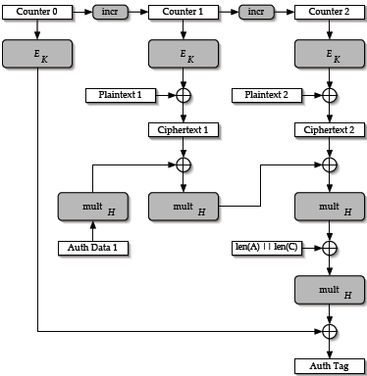

Authenticated Encryption with Associated Data
Salt
IV
0
Salt
IV
1
Salt
IV
2
AEAD is based on special
block cipher modes:
Block size: 128 bits
Key size: 128/256 bits
Tag size : 128/96/64 bits
Nonce size: 128 bits
32 bits 64 bits 32 bits
Recommended AEAD Modes:
AES-Galois/Counter Mode
AES-GMAC (auth. only)
Alternative AEAD Modes:
AES-CCM
CAMELLIA-GCM
CAMELLIA-CCM
Key K
Key K
Salt
IV
Counter
Hash Subkey Derivation
0………………..0
Key K
Hash Subkey H
Notes:
NIST Special Publication 800-38D: Recommendation for Block Cipher Modes
of Operation: Galois/Counter Mode (GCM) and GMAC, November 2007
http://csrc.nist.gov/publications/nistpubs/800-38D/SP-800-38D.pdf
This Recommendation specifies an algorithm called Galois/Counter Mode (GCM) for authenticated encryption with associated data. GCM is constructed from an approved symmetric key block cipher with a block size of 128 bits, such as the Advanced Encryption Standard (AES) algorithm. Thus, GCM is a mode of operation of the AES algorithm.
GCM provides assurance of the confidentiality of data using a variation of the Counter mode of operation for encryption. GCM provides assurance of the authenticity of the confidential data (up to about 64 gigabytes per invocation) using a universal hash function that is defined over a binary Galois (i.e., finite) field. GCM can also provide authentication assurance for additional data (of practically unlimited length per invocation) that is not encrypted.
If the GCM input is restricted to data that is not to be encrypted, the resulting specialization of GCM, called GMAC, is simply an authentication mode on the input data. In the rest of this document, statements about GCM also apply to GMAC.
The two functions of GCM are called authenticated encryption and authenticated decryption. Each of these functions is relatively efficient and parallelizable; consequently, high-throughput implementations are possible in both hardware and software.
IPsec ESP Overhead: 8 octet IV, 16/12/8 octet authentication tag
• RFC 4106 “The Use of Galois/Counter Mode (GCM) in IPsec ESP”
• RFC 4309 “Using AES CCM Mode with IPsec ESP“
• RFC 4312 “The Camellia Cipher Algorithm and Its Use With IPsec”

Slide 35
IPsec Policies in the Linux Kernel
carol: ip -s xfrm policy
src 10.1.0.0/24 dst 10.3.0.1/32 uid 0
dir in action allow index 800 priority 1760 ...
lifetime config:
limit: soft (INF)(bytes), hard (INF)(bytes)
limit: soft (INF)(packets), hard (INF)(packets)
expire add: soft 0(sec), hard 0(sec)
expire use: soft 0(sec), hard 0(sec)
lifetime current:
0(bytes), 0(packets)
add 2009-10-22 20:34:37 use 2009-10-22 20:34:39
tmpl src 192.168.0.1 dst 192.168.0.100
proto esp spi 0x00000000(0) reqid 1(0x00000001) mode tunnel
src 10.3.0.1/32 dst 10.1.0.0/24 uid 0
dir out action allow index 793 priority 1680 ...
lifetime config:
limit: soft (INF)(bytes), hard (INF)(bytes)
limit: soft (INF)(packets), hard (INF)(packets)
expire add: soft 0(sec), hard 0(sec)
expire use: soft 0(sec), hard 0(sec)
lifetime current:
0(bytes), 0(packets)
add 2009-10-22 20:34:37 use 2009-10-22 20:34:38
tmpl src 192.168.0.100 dst 192.168.0.1
proto esp spi 0x00000000(0) reqid 1(0x00000001) mode tunnel
Notes:
N Rekeying Notification (optional)
SA_{i} Suite of cryptographic proposals for the Child SA (ESP and/or AH)
N_{i} Initiator Nonce
KE_{i} Initiatior public factor for the Diffie-Hellman Key Exchange (optional PFS)
TS_{i} Initiator Traffic Selectors (subnets behind the Initiator)
TS_{r} Responder Traffic Selectors (subnets behind the Responder
SA1_{r} Selection of a cryptographic proposal for the IKE SA
N_{r} Responder Nonce
KE_{r} Responder public factor for the Diffie-Hellman Key Exchange (optional PFS)
TS_{i} Initiator Traffic Selectors (subnets behind the Initiator)
TS_{r} Responder Traffic Selectors (subnets behind the Responder

Slide 36
IPsec Policies in the Linux Kernel
moon: ip -s xfrm policy
src 10.3.0.1/32 dst 10.1.0.0/24 uid 0
dir fwd action allow index 954 priority 1680 ...
lifetime config:
limit: soft (INF)(bytes), hard (INF)(bytes)
limit: soft (INF)(packets), hard (INF)(packets)
expire add: soft 0(sec), hard 0(sec)
expire use: soft 0(sec), hard 0(sec)
lifetime current:
0(bytes), 0(packets)
add 2009-10-22 20:34:36 use 2009-10-22 20:34:39
tmpl src 192.168.0.100 dst 192.168.0.1
proto esp spi 0x00000000(0) reqid 1(0x00000001) mode tunnel
src 10.1.0.0/24 dst 10.3.0.1/32 uid 0
dir out action allow index 937 priority 1760 ...
lifetime config:
limit: soft (INF)(bytes), hard (INF)(bytes)
limit: soft (INF)(packets), hard (INF)(packets)
expire add: soft 0(sec), hard 0(sec)
expire use: soft 0(sec), hard 0(sec)
lifetime current:
0(bytes), 0(packets)
add 2009-10-22 20:34:36 use 2009-10-22 20:34:39
tmpl src 192.168.0.1 dst 192.168.0.100
proto esp spi 0x00000000(0) reqid 1(0x00000001) mode tunnel
Notes:
N Rekeying Notification (optional)
SA_{i} Suite of cryptographic proposals for the Child SA (ESP and/or AH)
N_{i} Initiator Nonce
KE_{i} Initiatior public factor for the Diffie-Hellman Key Exchange (optional PFS)
TS_{i} Initiator Traffic Selectors (subnets behind the Initiator)
TS_{r} Responder Traffic Selectors (subnets behind the Responder
SA1_{r} Selection of a cryptographic proposal for the IKE SA
N_{r} Responder Nonce
KE_{r} Responder public factor for the Diffie-Hellman Key Exchange (optional PFS)
TS_{i} Initiator Traffic Selectors (subnets behind the Initiator)
TS_{r} Responder Traffic Selectors (subnets behind the Responder

Slide 37
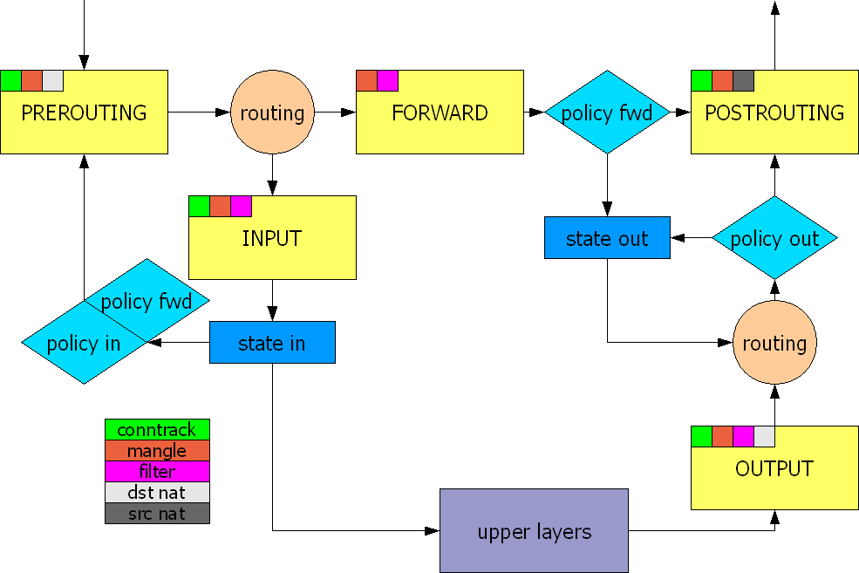
NETKEY Hooks in Linux Netfilter
Notes:
N Rekeying Notification (optional)
SA_{i} Suite of cryptographic proposals for the Child SA (ESP and/or AH)
N_{i} Initiator Nonce
KE_{i} Initiatior public factor for the Diffie-Hellman Key Exchange (optional PFS)
TS_{i} Initiator Traffic Selectors (subnets behind the Initiator)
TS_{r} Responder Traffic Selectors (subnets behind the Responder
SA1_{r} Selection of a cryptographic proposal for the IKE SA
N_{r} Responder Nonce
KE_{r} Responder public factor for the Diffie-Hellman Key Exchange (optional PFS)
TS_{i} Initiator Traffic Selectors (subnets behind the Initiator)
TS_{r} Responder Traffic Selectors (subnets behind the Responder

Slide 38
IKE SA and IPsec SA Rekeying Criteria
#ipsec.conf
conn %default
ikelifetime=180m # default 180m
lifetime=60m # default 60m
lifebytes=500000000 # default 0 (no hard limit)
lifepackets=1000000 # default 0 (no hard limit)
margintime=6m # default 9m
marginbytes=50000000 # default 0 (no soft limit)
marginpackets=100000 # default 0 (no soft limit)
rekeyfuzz=50% # default 100%
keyingtries=1 # default 0 (forever)
rekey=yes # default yes
reauth=no # default yes
Legacy parameters:
keylife: synonym for lifetime
rekeymargin: synonym for margintime
Notes:
N Rekeying Notification (optional)
SA_{i} Suite of cryptographic proposals for the Child SA (ESP and/or AH)
N_{i} Initiator Nonce
KE_{i} Initiatior public factor for the Diffie-Hellman Key Exchange (optional PFS)
TS_{i} Initiator Traffic Selectors (subnets behind the Initiator)
TS_{r} Responder Traffic Selectors (subnets behind the Responder
SA1_{r} Selection of a cryptographic proposal for the IKE SA
N_{r} Responder Nonce
KE_{r} Responder public factor for the Diffie-Hellman Key Exchange (optional PFS)
TS_{i} Initiator Traffic Selectors (subnets behind the Initiator)
TS_{r} Responder Traffic Selectors (subnets behind the Responder

Slide 39
IPsec Security Associations in the Kernel
carol: ip -s xfrm state
src 192.168.0.100 dst 192.168.0.1
proto esp spi 0xc77ca4c3(3346834627) reqid 1(0x00000001) mode tunnel
replay-window 32 seq 0x00000000 flag 20 (0x00100000)
auth hmac(sha1) 0x98fe271fd31ba795f158ae17487cb85f8682aefc (160 bits)
enc cbc(aes) 0x3d0567d65694fcbbfd3257f55b497d6a (128 bits)
lifetime config:
limit: soft 445929743(bytes), hard 500000000(bytes)
limit: soft 871034(packets), hard 1000000(packets)
expire add: soft 3065(sec), hard 3600(sec)
expire use: soft 0(sec), hard 0(sec)
lifetime current:
84(bytes), 1(packets)
add 2009-10-22 20:34:37 use 2009-10-22 20:34:38
stats:
replay-window 0 replay 0 failed 0
src 192.168.0.1 dst 192.168.0.100
proto esp spi 0xc46038e1(3294640353) reqid 1(0x00000001) mode tunnel
replay-window 32 seq 0x00000000 flag 20 (0x00100000)
auth hmac(sha1) 0x4e2b044e2835297d3f73bbf99289f369ae2d3ed5 (160 bits)
enc cbc(aes) 0xd2d83f5d7e496ddc9483be57dbbb2757 (128 bits)
...
Notes:
N Rekeying Notification (optional)
SA_{i} Suite of cryptographic proposals for the Child SA (ESP and/or AH)
N_{i} Initiator Nonce
KE_{i} Initiatior public factor for the Diffie-Hellman Key Exchange (optional PFS)
TS_{i} Initiator Traffic Selectors (subnets behind the Initiator)
TS_{r} Responder Traffic Selectors (subnets behind the Responder
SA1_{r} Selection of a cryptographic proposal for the IKE SA
N_{r} Responder Nonce
KE_{r} Responder public factor for the Diffie-Hellman Key Exchange (optional PFS)
TS_{i} Initiator Traffic Selectors (subnets behind the Initiator)
TS_{r} Responder Traffic Selectors (subnets behind the Responder

Slide 40
Linux Kongress 2009 Dresden
Interaction with the
Linux Netfilter Firewall

Slide 41
Full Integration with Linux Netfilter Firewall
carol
Chain INPUT (policy DROP 0 packets, 0 bytes)
pkts bytes target prot in out source destination
1 84 ACCEPT all eth0 * 10.1.0.0/24 10.3.0.1
policy match dir in pol ipsec reqid 1 proto 50
1 152 ACCEPT esp eth0 * 0.0.0.0/0 0.0.0.0/0
2 2069 ACCEPT udp eth0 * 0.0.0.0/0 0.0.0.0/0 udp spt:500 dpt:500
Chain OUTPUT (policy DROP 0 packets, 0 bytes)
pkts bytes target prot in out source destination
1 84 ACCEPT all * eth0 10.3.0.1 10.1.0.0/24
policy match dir out pol ipsec reqid 1 proto 50
1 152 ACCEPT esp * eth0 0.0.0.0/0 0.0.0.0/0
2 2456 ACCEPT udp * eth0 0.0.0.0/0 0.0.0.0/0 udp spt:500 dpt:500
After the successful establishment/deletion of a CHILD_SA the updown plugin dynamically inserts and removes an INPUT and OUTPUT Netfilter IPsec ESP policy matching rule via the iptables command executed by the /usr/libexec/ipsec/_updown shell script.
Notes:
N Rekeying Notification (optional)
SA_{i} Suite of cryptographic proposals for the Child SA (ESP and/or AH)
N_{i} Initiator Nonce
KE_{i} Initiatior public factor for the Diffie-Hellman Key Exchange (optional PFS)
TS_{i} Initiator Traffic Selectors (subnets behind the Initiator)
TS_{r} Responder Traffic Selectors (subnets behind the Responder
SA1_{r} Selection of a cryptographic proposal for the IKE SA
N_{r} Responder Nonce
KE_{r} Responder public factor for the Diffie-Hellman Key Exchange (optional PFS)
TS_{i} Initiator Traffic Selectors (subnets behind the Initiator)
TS_{r} Responder Traffic Selectors (subnets behind the Responder

Slide 42
Full Integration with Linux Netfilter Firewall
moon
Chain INPUT (policy DROP 0 packets, 0 bytes)
pkts bytes target prot in out source destination
2 304 ACCEPT esp eth0 * 0.0.0.0/0 0.0.0.0/0
4 4896 ACCEPT udp eth0 * 0.0.0.0/0 0.0.0.0/0 udp spt:500 dpt:500
Chain FORWARD (policy DROP 0 packets, 0 bytes)
pkts bytes target prot in out source destination
1 84 ACCEPT all eth0 * 10.3.0.2 10.1.0.20
policy match dir in pol ipsec reqid 2 proto 50
1 84 ACCEPT all * eth0 10.1.0.20 10.3.0.2
policy match dir out pol ipsec reqid 2 proto 50
1 84 ACCEPT all eth0 * 10.3.0.1 10.1.0.0/24
policy match dir in pol ipsec reqid 1 proto 50
1 84 ACCEPT all * eth0 10.1.0.0/24 10.3.0.1
policy match dir out pol ipsec reqid 1 proto 50
Chain OUTPUT (policy DROP 0 packets, 0 bytes)
pkts bytes target prot in out source destination
2 304 ACCEPT esp * eth0 0.0.0.0/0 0.0.0.0/0
4 4138 ACCEPT udp * eth0 0.0.0.0/0 0.0.0.0/0 udp spt:500 dpt:500
On gateways the updown plugin dynamically inserts and removes two FORWARD Netfilter IPsec ESP policy matching rules per CHILD_SA.
lefthostaccess=yes additionally adds an
input/output rule to access the GW itself.
Notes:
N Rekeying Notification (optional)
SA_{i} Suite of cryptographic proposals for the Child SA (ESP and/or AH)
N_{i} Initiator Nonce
KE_{i} Initiatior public factor for the Diffie-Hellman Key Exchange (optional PFS)
TS_{i} Initiator Traffic Selectors (subnets behind the Initiator)
TS_{r} Responder Traffic Selectors (subnets behind the Responder
SA1_{r} Selection of a cryptographic proposal for the IKE SA
N_{r} Responder Nonce
KE_{r} Responder public factor for the Diffie-Hellman Key Exchange (optional PFS)
TS_{i} Initiator Traffic Selectors (subnets behind the Initiator)
TS_{r} Responder Traffic Selectors (subnets behind the Responder

Slide 43
Static IPsec ESP Policy Matching Rules
moon
Chain INPUT (policy DROP 0 packets, 0 bytes)
pkts bytes target prot in out source destination
2 304 ACCEPT esp eth0 * 0.0.0.0/0 0.0.0.0/0
4 4896 ACCEPT udp eth0 * 0.0.0.0/0 0.0.0.0/0 udp spt:500 dpt:500
Chain FORWARD (policy DROP 0 packets, 0 bytes)
pkts bytes target prot in out source destination
2 168 ACCEPT all * * 0.0.0.0/0 0.0.0.0/0
policy match dir in pol ipsec proto 50
2 168 ACCEPT all * * 0.0.0.0/0 0.0.0.0/0
policy match dir out pol ipsec proto 50
Chain OUTPUT (policy DROP 0 packets, 0 bytes)
pkts bytes target prot in out source destination
2 304 ACCEPT esp * eth0 0.0.0.0/0 0.0.0.0/0
4 4138 ACCEPT udp * eth0 0.0.0.0/0 0.0.0.0/0 udp spt:500 dpt:500
leftfirewall=yes can be omitted and the updown plugin doesn‘t have to
be built (./configure --disable-updown).
Notes:
N Rekeying Notification (optional)
SA_{i} Suite of cryptographic proposals for the Child SA (ESP and/or AH)
N_{i} Initiator Nonce
KE_{i} Initiatior public factor for the Diffie-Hellman Key Exchange (optional PFS)
TS_{i} Initiator Traffic Selectors (subnets behind the Initiator)
TS_{r} Responder Traffic Selectors (subnets behind the Responder
SA1_{r} Selection of a cryptographic proposal for the IKE SA
N_{r} Responder Nonce
KE_{r} Responder public factor for the Diffie-Hellman Key Exchange (optional PFS)
TS_{i} Initiator Traffic Selectors (subnets behind the Initiator)
TS_{r} Responder Traffic Selectors (subnets behind the Responder

Slide 44
Linux Kongress 2009 Dresden
Dead Peer Detection (DPD)

Slide 45
Activation of Dead Peer Detection
#ipsec.conf for roadwarrior carol
conn %default
dpddelay=60
dpdaction=restart
#ipsec.conf for gateway moon
conn %default
dpddelay=60
dpdaction=clear
Oct 24 11:45:10 13[IKE] CHILD_SA home{1} established with SPIs c50810d9_i c8485f4a_o
Oct 24 11:46:10 16[NET] received packet: from 192.168.0.1[500] to 192.168.0.100[500]
Oct 24 11:46:10 16[ENC] parsed INFORMATIONAL request 0 [ ]
Oct 24 11:46:10 16[ENC] generating INFORMATIONAL response 0 [ ]
Oct 24 11:46:10 16[NET] sending packet: from 192.168.0.100[500] to 192.168.0.1[500]
Oct 24 11:47:09 09[IKE] sending DPD request
Oct 24 11:47:09 09[ENC] generating INFORMATIONAL request 2 [ ]
Oct 24 11:47:09 09[NET] sending packet: from 192.168.0.100[500] to 192.168.0.1[500]
Oct 24 11:47:13 03[IKE] retransmit 1 of request with message ID 2
Oct 24 11:47:13 03[NET] sending packet: from 192.168.0.100[500] to 192.168.0.1[500]
Oct 24 11:47:20 11[IKE] retransmit 2 of request with message ID 2
Oct 24 11:47:20 11[NET] sending packet: from 192.168.0.100[500] to 192.168.0.1[500]
Oct 24 11:47:33 08[IKE] retransmit 3 of request with message ID 2
Oct 24 11:47:33 08[NET] sending packet: from 192.168.0.100[500] to 192.168.0.1[500]
Oct 24 11:47:56 12[IKE] retransmit 4 of request with message ID 2
Oct 24 11:47:56 12[NET] sending packet: from 192.168.0.100[500] to 192.168.0.1[500]
Oct 24 11:48:38 14[IKE] retransmit 5 of request with message ID 2
Oct 24 11:48:38 14[NET] sending packet: from 192.168.0.100[500] to 192.168.0.1[500]
Oct 24 11:49:54 16[IKE] giving up after 5 retransmits
Oct 24 11:49:54 16[IKE] restarting CHILD_SA home
Oct 24 11:49:54 16[IKE] initiating IKE_SA home[2] to 192.168.0.1
Notes:
N Rekeying Notification (optional)
SA_{i} Suite of cryptographic proposals for the Child SA (ESP and/or AH)
N_{i} Initiator Nonce
KE_{i} Initiatior public factor for the Diffie-Hellman Key Exchange (optional PFS)
TS_{i} Initiator Traffic Selectors (subnets behind the Initiator)
TS_{r} Responder Traffic Selectors (subnets behind the Responder
SA1_{r} Selection of a cryptographic proposal for the IKE SA
N_{r} Responder Nonce
KE_{r} Responder public factor for the Diffie-Hellman Key Exchange (optional PFS)
TS_{i} Initiator Traffic Selectors (subnets behind the Initiator)
TS_{r} Responder Traffic Selectors (subnets behind the Responder

Slide 46
Linux Kongress 2009 Dresden
Remote-Access
with Mixed Authentication

Slide 47
IKEv1 Main Mode using Pre-Shared Keys
Initiator
UDP/500
Responder
IKE
Header
ISAKMP SA
Proposal
1
IKE
Header
ISAKMP SA
Response
2
IKE
Header
DH Key
Exchange
N_{i}
3
IKE
Header
DH Key
Exchange
N_{r}
4
encrypted
IKE
Header
ID_{i}
Hash_{i}
5
encrypted
6
IKE
Header
ID_{r}
Hash_{r}
Pre-shared key
● is worked into Hash
● is part of the IKE session key

Slide 48
IKEv1 Aggressive Mode using PSK
Initiator
UDP/500
Responder
IKE
Header
ISAKMP SA
Proposal
DH Key
Exchange
N_{i}
ID_{i}
1
IKE
Header
ISAKMP SA
Response
DH Key
Exchange
N_{r}
ID_{r}
Hash_{r}
2
Hash_{i}
3
Unencrypted IKE Aggressive Mode messages carrying cleartext IDs can be easily sniffed by a passive attacker.
Pre-Shared Key is worked into Hash_{r} , together with other known parameters, so that an off-line cracking attack becomes possible.

Slide 49
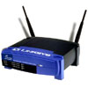

Man-in-the-Middle Attack possible with IKEv1 Aggressive Mode and XAUTH
VPN Client
Group Password
Attacker
Group Password
XAUTH
Wireless LAN User
1
bodo
aznHu4Um
XAUTH
Username:
bodo
Man-in-the-Middle
Password:
2
aznHu4Um
WLAN Access Point
VPN Gateway
With IKE Aggressive Mode, use
One-Time Password scheme (e.g. SecureID).

Slide 50
IKEv2 Mixed PSK/RSA Authentication
#ipsec.secrets for roadwarrior carol
carol@strongswan.org : PSK "gaga5"
#ipsec.secrets for gateway moon
: RSA moonKey.pem
carol@strongswan.org : \
PSK „gaga5"
dave@strongswan.org : \
PSK "jVzONCF02ncsgiSlmIXeqhGN"
#ipsec.conf for roadwarrior carol
conn home
keyexchange=ikev2
leftauth=psk
left=%defaultroute
leftid=carol@strongswan.org
leftfirewall=yes
rightauth=pubkey
right=192.168.0.1
rightid=@moon.strongswan.org
rightsubnet=0.0.0.0/0
auto=start
#ipsec.conf for gateway moon
conn rw
keyexchange=ikev2
leftauth=pubkey
left=%any
leftsubnet=10.1.0.0/16
leftcert=moonCert.pem
leftid=@moon.strongswan.org
leftfirewall=yes
rightauth=psk
right=%any
rightsourceip=10.3.0.0/24
auto=add
With weak PSKs vulnerable to
MITM dictionary attacks since user sends credentials first!
Users choose weak passwords!
Notes:
N Rekeying Notification (optional)
SA_{i} Suite of cryptographic proposals for the Child SA (ESP and/or AH)
N_{i} Initiator Nonce
KE_{i} Initiatior public factor for the Diffie-Hellman Key Exchange (optional PFS)
TS_{i} Initiator Traffic Selectors (subnets behind the Initiator)
TS_{r} Responder Traffic Selectors (subnets behind the Responder
SA1_{r} Selection of a cryptographic proposal for the IKE SA
N_{r} Responder Nonce
KE_{r} Responder public factor for the Diffie-Hellman Key Exchange (optional PFS)
TS_{i} Initiator Traffic Selectors (subnets behind the Initiator)
TS_{r} Responder Traffic Selectors (subnets behind the Responder

Slide 51
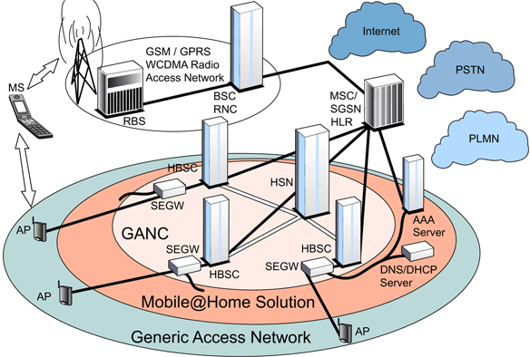
IKEv2 EAP Authentication
IPsec
The 3GPP Generic Access Network (GAN) enables GSM and UMTS services to be delivered over unlicensed WLAN Access Points (APs).
Using IKEv2 EAP-SIM or EAP-AKA authentication the Mobile Station (MS) sets up an IPsec tunnel to the GAN Controller (GANC).

Slide 52
Linux Kongress 2009 Dresden
Interoperability with the
Windows 7 Agile VPN Client

Slide 53
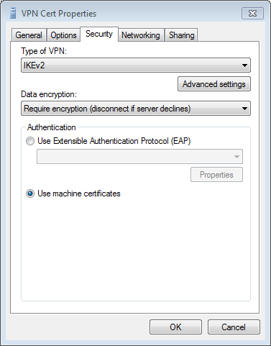
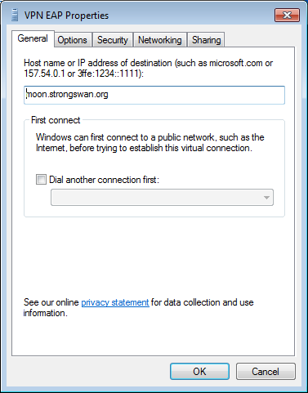
Windows 7 VPN with Machine Certificates
Gateway certificate must contain
host name [or IP address] and the serverAuth extendedKeyUsage flag.

Slide 54
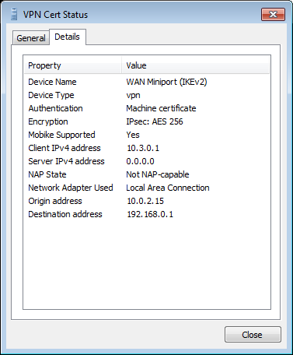
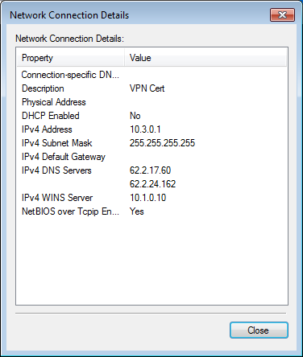
Windows 7 VPN Cert Status
# strongswan.conf for gateway moon
charon {
dns1=62.2.17.60
dns2=62.2.24.162
nbns1=10.1.0.10
}

Slide 55
Local EAP Credentials Management
# ipsec.secrets for gateway moon
: RSA moonKey.pem
carol : EAP "tuxmux"
dave : EAP "grummel“
# ipsec.conf for gateway moon
conn rw
keyexchange=ikev2
ike=aes128-aes256-sha256-sha1-modp2048-modp1024!
esp=aes128-aes256-sha1!
left=192.168.0.1
leftsubnet=10.1.0.0/16
leftcert=moonCert.pem
leftid=@moon.strongswan.org
leftauth=pubkey
leftfirewall=yes
right=%any
rightsendcert=never
rightsourceip=10.3.0.0/24
rightauth=eap-mschapv2
eap_identity=%any
auto=add

Slide 56
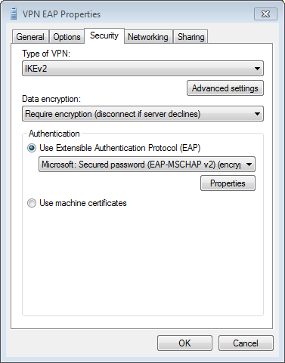
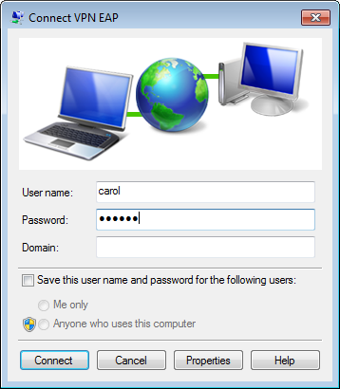
Windows 7 VPN with EAP Authentication
Gateway certificate must contain
host name [or IP address] and the serverAuth extendedKeyUsage flag.

Slide 57
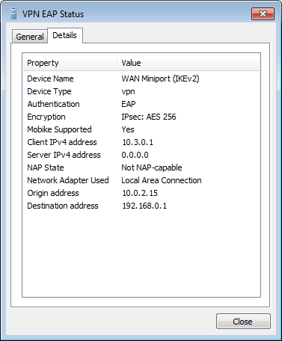

Windows 7 VPN EAP Status
# strongswan.conf for gateway moon
charon {
dns1=62.2.17.60
dns2=62.2.24.162
nbns1=10.1.0.10
}

Slide 58
Linux Kongress 2009 Dresden
The strongSwan
NetworkManager Plugin

Slide 59
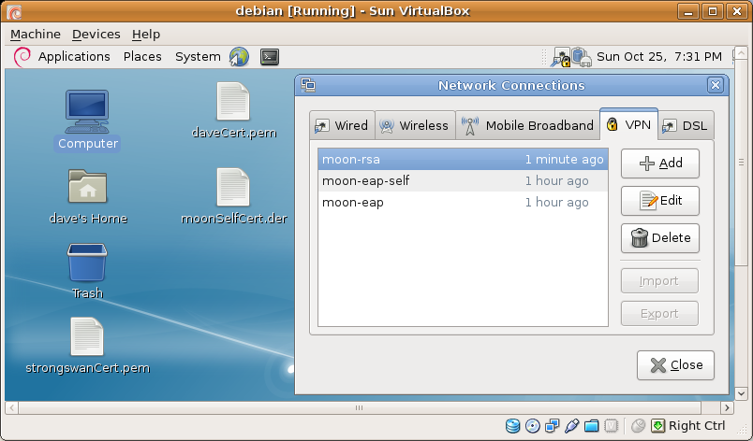
strongSwan NetworkManager VPN Plugin
User authentication: RSA, EAP-GTC, EAP-MSCHAPv2, EAP-...
Server authentication: Self-Signed Certificate or CA Certificate

Slide 60
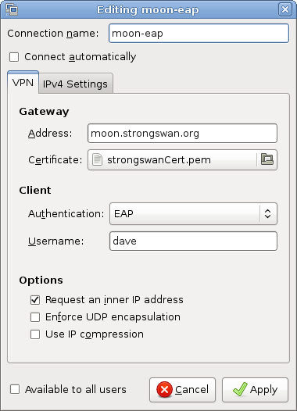
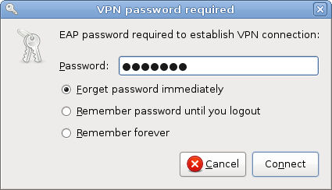
strongSwan NetworkManager with EAP I
If a CA root certificate is specified then the hostname [or IP address] of the VPN gateway must be contained as a subjectAltName in the received gateway certificate.

Slide 61
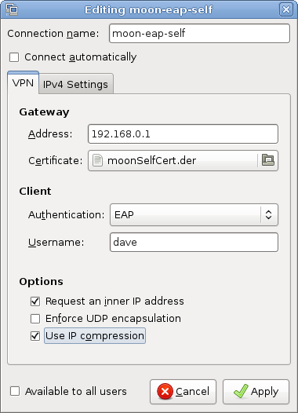
strongSwan NetworkManager with EAP II
As an alternative the self-signed certificate of the VPN gateway can be directly imported.

Slide 62
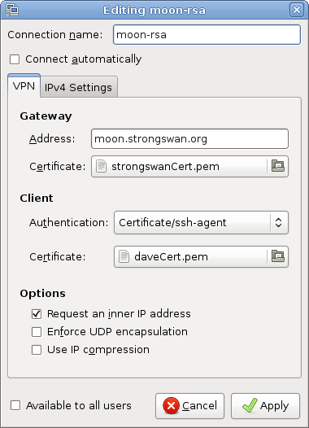
strongSwan NetworkManager with RSA
The private RSA key stored in .ssh/id_rsa in PKCS#1 PEM format is managed by the ssh-agent and can be directly by strongSwan via the agent plugin.

Slide 63
Connection status on gateway moon
Virtual IP pools (size/online/offline):
rw: 255/2/0
Listening IP addresses:
Connections:
rw: 192.168.0.1...%any
rw: local: [moon.strongswan.org] uses public key authentication
rw: cert: "C=CH, O=Linux strongSwan, CN=moon.strongswan.org"
rw: remote: [%any] uses EAP_MSCHAPV2 authentication with EAP identity '%any'
rw: child: 10.1.0.0/16 === dynamic
Security Associations:
rw[1]: ESTABLISHED 5 minutes ago, 192.168.0.1[moon.strongswan.org]...
192.168.0.254[10.0.2.15]
rw[1]: IKE SPIs: 6d64603959c40c35_i cedb9920fa698283_r*,
rw[1]: IKE proposal: AES_CBC_256/HMAC_SHA1_96/PRF_HMAC_SHA1/MODP_1024
rw{1}: INSTALLED, TUNNEL, ESP in UDP SPIs: c07e2ac6_i 2566d5f3_o
rw{1}: AES_CBC_256/HMAC_SHA1_96, 480 bytes_i (53s ago), 480 bytes_o (53s ago)
rw{1}: 10.1.0.0/16 === 10.3.0.1/32
rw[3]: ESTABLISHED 20 seconds ago, 192.168.0.1[moon.strongswan.org]...
192.168.0.254[dave]
rw[3]: IKE SPIs: d090764d9d84fa0e_i f80f74f0e109e453_r*,
rw[3]: IKE proposal: AES_CBC_128/HMAC_SHA2_256_128/PRF_HMAC_SHA2_256/MODP_2048
rw{2}: INSTALLED, TUNNEL, ESP in UDP SPIs: c73ddbf5_i c60375cc_o
rw{2}: AES_CBC_128/HMAC_SHA1_96, 840 bytes_i (1s ago), 840 bytes_o (1s ago),
rw{2}: 10.1.0.0/16 === 10.3.0.2/32

Slide 64
Linux Kongress 2009 Dresden
EAP-Radius based
Authentication

Slide 65
RADIUS Server Configuration
moon
radius server
# strongswan.conf of gateway moon
charon {
plugins {
eap-radius {
secret = gv6URkSs
server = 10.1.0.10
}
}
}
# /etc/raddb/clients.conf
client 10.1.0.1 {
secret = gv6URkSs
shortname = moon
# /etc/raddb/eap.conf
eap {
default_eap_type = md5
md5 {
}
}
# ipsec.conf of gateway moon
conn rw-eap
left=192.168.0.1
leftsubnet=10.1.0.0/16
leftid=@moon.strongswan.org
leftcert=moonCert.pem
leftauth=pubkey
leftfirewall=yes
right=%any
rightsendcert=never
rightsourceip=10.3.0.0/24
rightauth=eap-radius
eap_identity=%any
auto=add
# /etc/raddb/proxy.conf
realm LOCAL {
type = radius
authhost = LOCAL
accthost = LOCAL
}
# /etc/raddb/users
carol Cleartext-Password := "tuxmux"
dave Cleartext-Password := "grummel"

Slide 66
Linux Kongress 2009 Dresden
strongSwan
Software Architecture

Slide 67
IKEv2 Daemon – Software Architecture
credentials
backends
receiver
scheduler
IKE SA
M
a
n
a
g
e
r
IKE
SA
CHILD SA
CHILD SA
socket
IKE
SA
CHILD SA
processor
sender
bus
kernel interface
file logger
sys logger
IPsec stack
charon
16 concurrent worker threads

Slide 68
Plugins for charon
smp
XML-based control and
management protocol.
charon
controller
stroke
P
l
u
g
i
n
L
o
a
d
e
r
Implementation:
strongSwan Manager
credentials
smp
nm
DBUS-based plugin
for NetworkManager
nm
backends
sql
bus
sql
Generic SQL interface
for configurations,
credentials & logging.
…
eap_aka
eap
eap_sim
Implementations:
SQLite & MySQL
eap_md5
eap_x
Any EAP protocol.
…

Slide 69
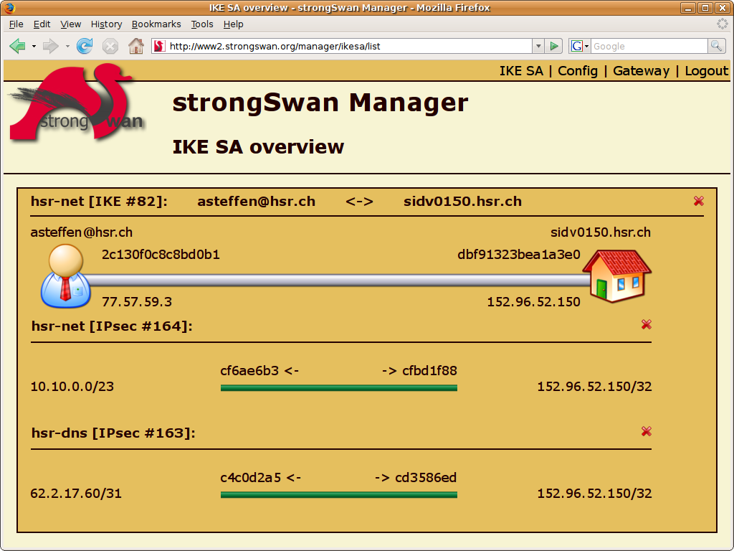
strongSwan Manager
take down
IKE SA
take down
IPsec SA
FastCGI written in C with ClearSilver templates
Notes:
N Rekeying Notification (optional)
SA_{i} Suite of cryptographic proposals for the Child SA (ESP and/or AH)
N_{i} Initiator Nonce
KE_{i} Initiatior public factor for the Diffie-Hellman Key Exchange (optional PFS)
TS_{i} Initiator Traffic Selectors (subnets behind the Initiator)
TS_{r} Responder Traffic Selectors (subnets behind the Responder
SA1_{r} Selection of a cryptographic proposal for the IKE SA
N_{r} Responder Nonce
KE_{r} Responder public factor for the Diffie-Hellman Key Exchange (optional PFS)
TS_{i} Initiator Traffic Selectors (subnets behind the Initiator)
TS_{r} Responder Traffic Selectors (subnets behind the Responder

Slide 70
strongSwan Entity Relationship Diagram
logs
pools
traffic_selectors
private_keys
leases
child_configs
shared_secrets
identities
identities
peer_configs
certificates
ike_configs
SQLite and MySQL implementations

Slide 71
Linux Kongress 2009 Dresden
Cryptographic Plugins

Slide 72
Plugins for libstrongswan
libstrongswan
aes
Non-US crypto code
No OpenSSL library
ECCN: No License
Required (NLR)
crypto
P
l
u
g
i
n
L
o
a
d
e
r
sha2
random
Factories
…
credentials
x509
…
sqlite
database
mysql
…
curl
Certificate retrieval (HASH-and-URL)
CRL fetching, OCSP
fetcher
ldap

Slide 73
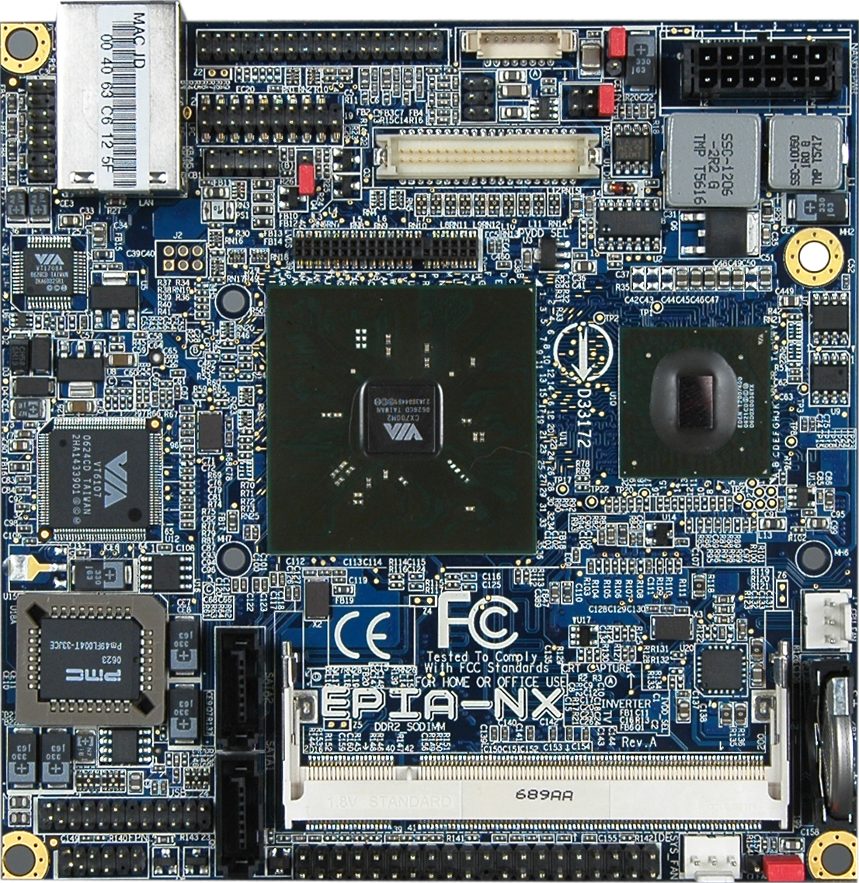
VIA EPIA-NX PadLock Crypto-Processor
padlock plugin
AES/SHA
HW acceleration
openssl plugin
uses libcrypto-0.9.8
OpenSSL library
- ECP DH groups
- ECDSA signatures
- HW engine support

Slide 74
The strongSwan PKI function
ipsec pki --gen --type ecdsa --size 521 > strongswanKey.der
ipsec pki --self --in strongswanKey.der –type ecdsa --lifetime 3650
--dn "C=CH, O=strongSwan, CN=strongSwan EC CA"
--ca --digest sha512 > strongswanCert.der
ipsec pki --gen --type ecdsa --size 384 > moonKey.der
ipsec pki --req --in moonKey.der --type ecdsa --digest sha384
--dn "C=CH, O=strongSwan, CN=moon.strongswan.org"
--san moon.strongswan.org > moonReq.der
ipsec pki --gen --type ecdsa --size 256 > carolKey.der
ipsec pki --req --in carolKey.der --type ecdsa --digest sha256
--dn "C=CH, O=strongSwan, CN=carol@strongswan.org"
--san carol@strongswan.org > carolReq.der
cat pki.opt
--type pkcs10 --lifetime 1825 --crl http://crl.strongswan.org/ecdsa.crl
--cacert strongswanCert.der --cakey strongswanKey.der --digest sha512
ipsec pki --issue -–options pki.opt --in moonReq.der --flag serverAuth
--serial 01 > moonCert.der
ipsec pki --issue -–options pki.opt --in carolReq.der
--serial 02 > carolCert.der

Slide 75
Suite B offers constant 128/192 Bit Security
# ipsec.secrets for gateway moon
: ECDSA moonKey.der
128 bit security requires 3072 bit RSA keys and DH groups!
In 2005 NSA proposes use of efficient elliptic curve cryptography.
Suite B use for IPsec defined in RFC 4869.
# ipsec.conf for gateway moon
conn rw
keyexchange=ikev2
ike=aes256-sha384-ecp384,aes128-sha256-ecp256!
esp=aes256gcm16,aes128gcm16!
leftsubnet=10.1.0.0/24
leftcert=moonCert.der
leftid=@moon.strongswan.org
right=%any
rightsourceip=10.3.0.0/24
auto=add
rw[1]: ESTABLISHED 9 seconds ago, 192.168.0.1[moon.strongswan.org]...
192.168.0.100[carol@strongswan.org]
rw[1]: IKE SPIs: 7c1dcd22a8266a3b_i 12bc51bc21994cdc_r*,
rw[1]: IKE proposal: AES_CBC_128/HMAC_SHA2_256_128/PRF_HMAC_SHA2_256/ECP_256
rw{1}: INSTALLED, TUNNEL, ESP SPIs: c05d34cd_i c9f09b38_o
rw{1}: AES_GCM_16_128, 84 bytes_i (6s ago), 84 bytes_o (6s ago),
rw{1}: 10.1.0.0/24 === 10.3.0.1/32

Slide 76
Linux Kongress 2009 Dresden
High Availability
using Cluster IP

Slide 77
strongSwan High-Availability Architecture
Intranet
Plain
Security Gateway 1
Security Gateway 2
HA Sync
Plugin
HA Failover
Plugin
HA Failover
Plugin
HA Sync
Plugin
Socket
Bus IF
Bus IF
Socket
Socket
Bus IF
Bus IF
Socket
Bus IF
Socket
Socket
Bus IF
IKEv2 charon
Daemon
Heartbeat
Daemon
Heartbeat
Daemon
IKEv2 charon
Daemon
IKE/IPsec SA Sync
IKE/IPsec SA Sync
Socket
Kernel IF
Socket
Socket
Kernel IF
Socket
IKE
XFRM
XFRM
IKE
IPsec Policies / IPsec SAs
eth1
eth1
IPsec Policies / IPsec SAs
Linux Netlink
Linux Netlink
eth2
ESP
eth2
ClusterIP
ClusterIP
eth0
eth0
ESP
Internet

Slide 78
Linux Kongress 2009 Dresden
IKEv2 Mediation Extension

Slide 79




Peer-to-Peer NAT-Traversal for IPsec
Client registration
Endpoint discovery
1.2.3.4:1025
aZ9ch2@m.org
7vnU3b@m.org
IKEv2
IKEv2
Endpoint relaying
Hole punching
(ICE, etc.)
Mediation Server
Mediation
Connection
Mediation
Connection
NAT Router
1.2.3.4:1025
NAT Router
5.6.7.8:3001
Mediation
Client
IKEv2
Mediation
Client
Mediated Connection
10.1.0.10:4500
10.2.0.10:4500
10.1.0.10
Direct ESP Tunnel
using NAT-Traversal
10.2.0.10
Peer Alice
Peer Bob

Slide 80
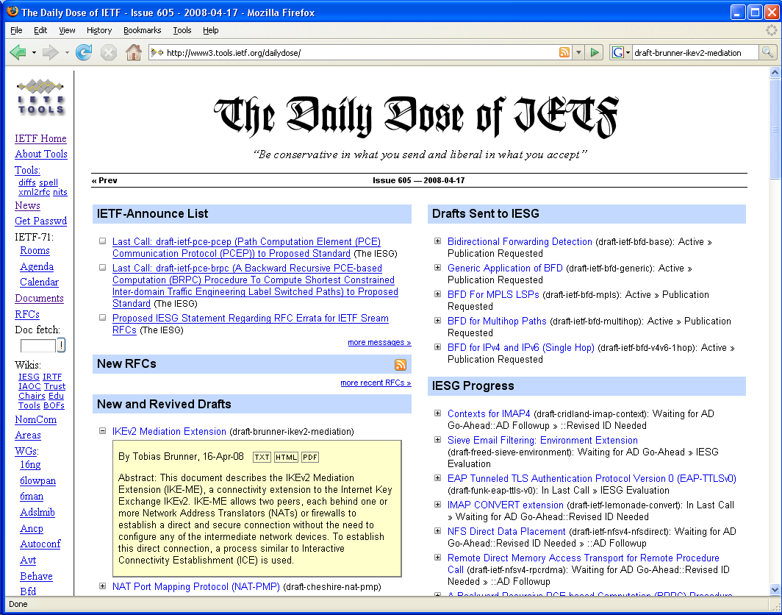
draft-brunner-ikev2-mediation released

Slide 81
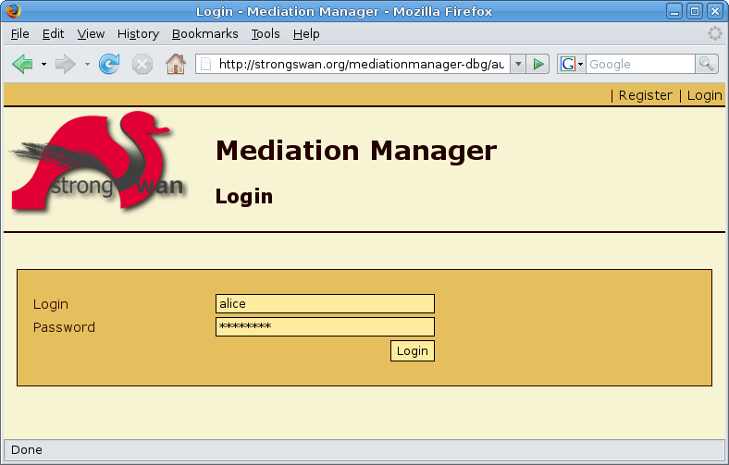
Login at the strongSwan Mediation Manager

Slide 82
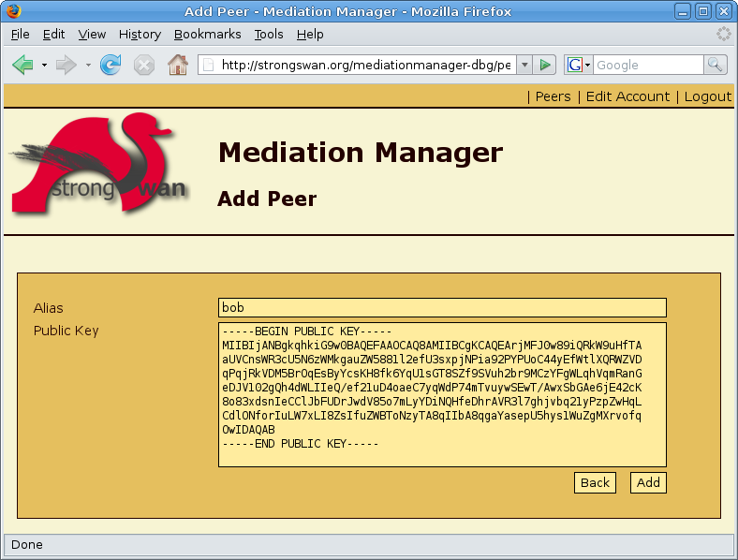
Register a Peer with the Mediation Manager

Slide 83
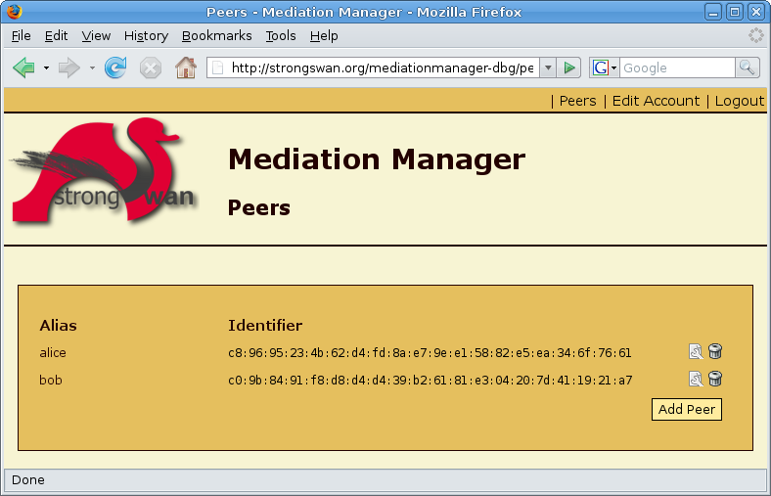
List of Registered Peers

